Slide 1
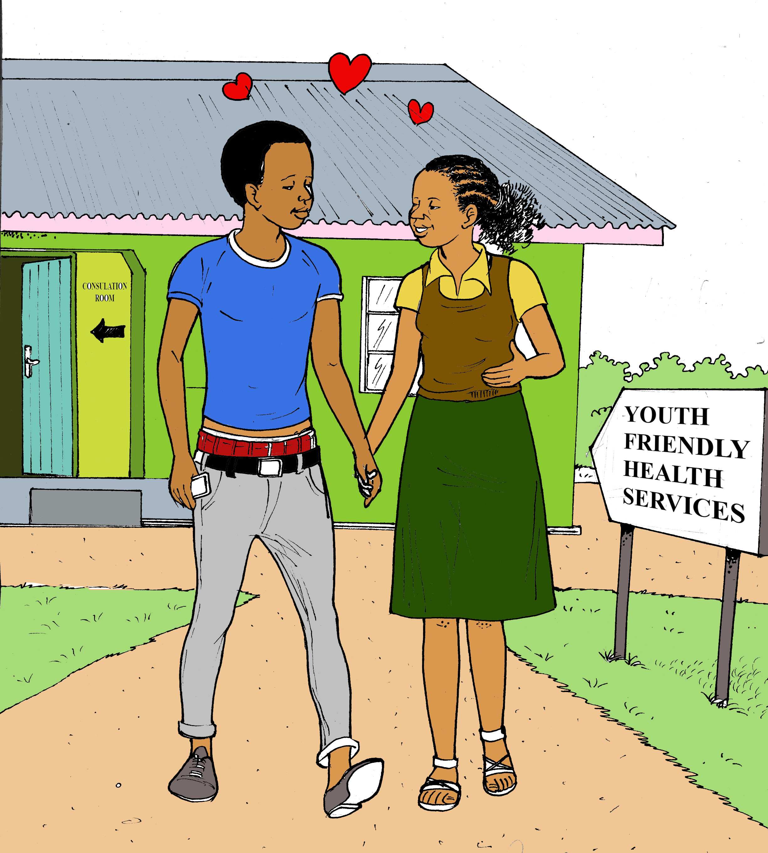
Guide to Sexual and reproductive health and Contraception

Slide 2
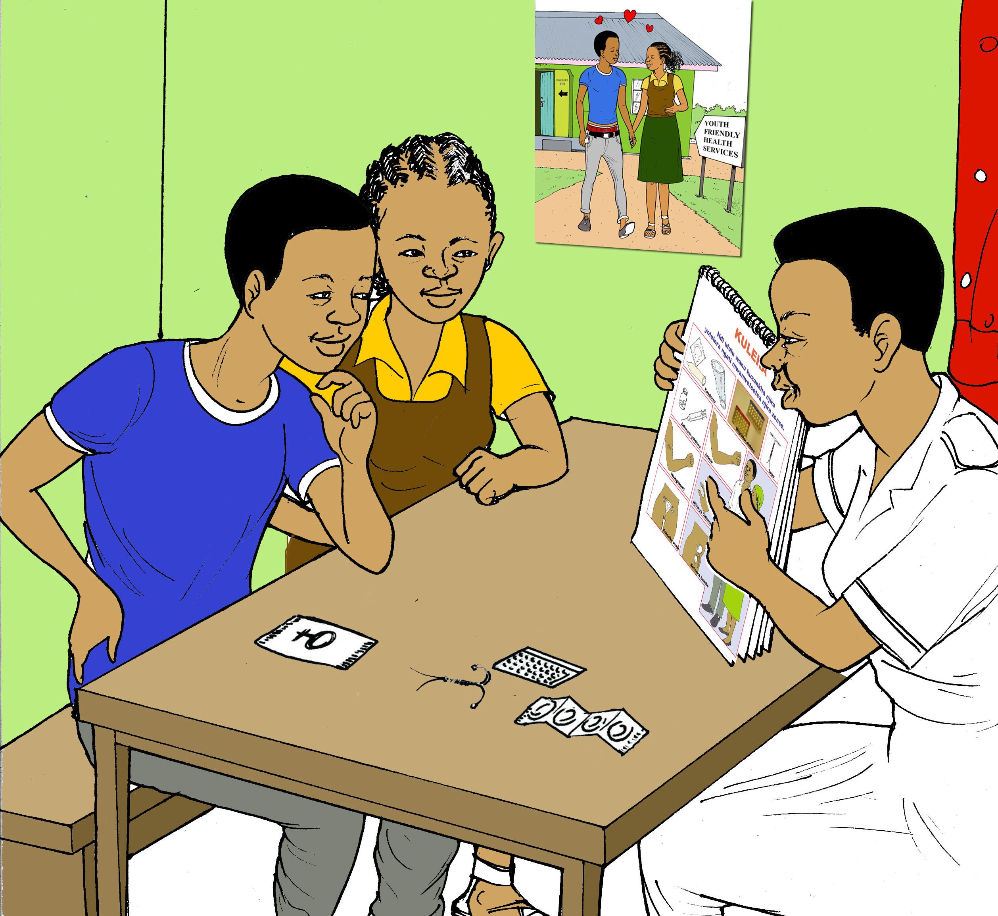
Guide to using manual
Discuss basics of male and female reproductive system and menstruation
Review basics of pregnancy
Describes various methods of contraception for males and females

Slide 3
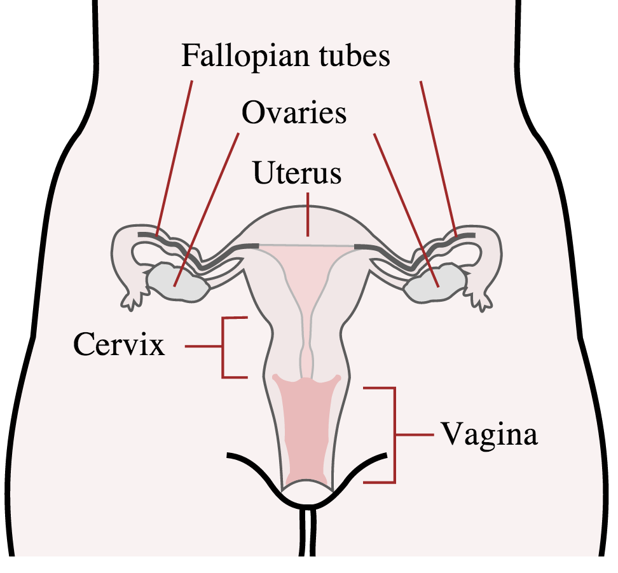
BASICS of menstruation
Once females reach a certain age, they begin a monthly cycle of menstruation (having a period/bleeding)
The menstruation cycle begins when an egg has been released from one of your ovaries and travels down the fallopian tube to the uterus

Slide 4
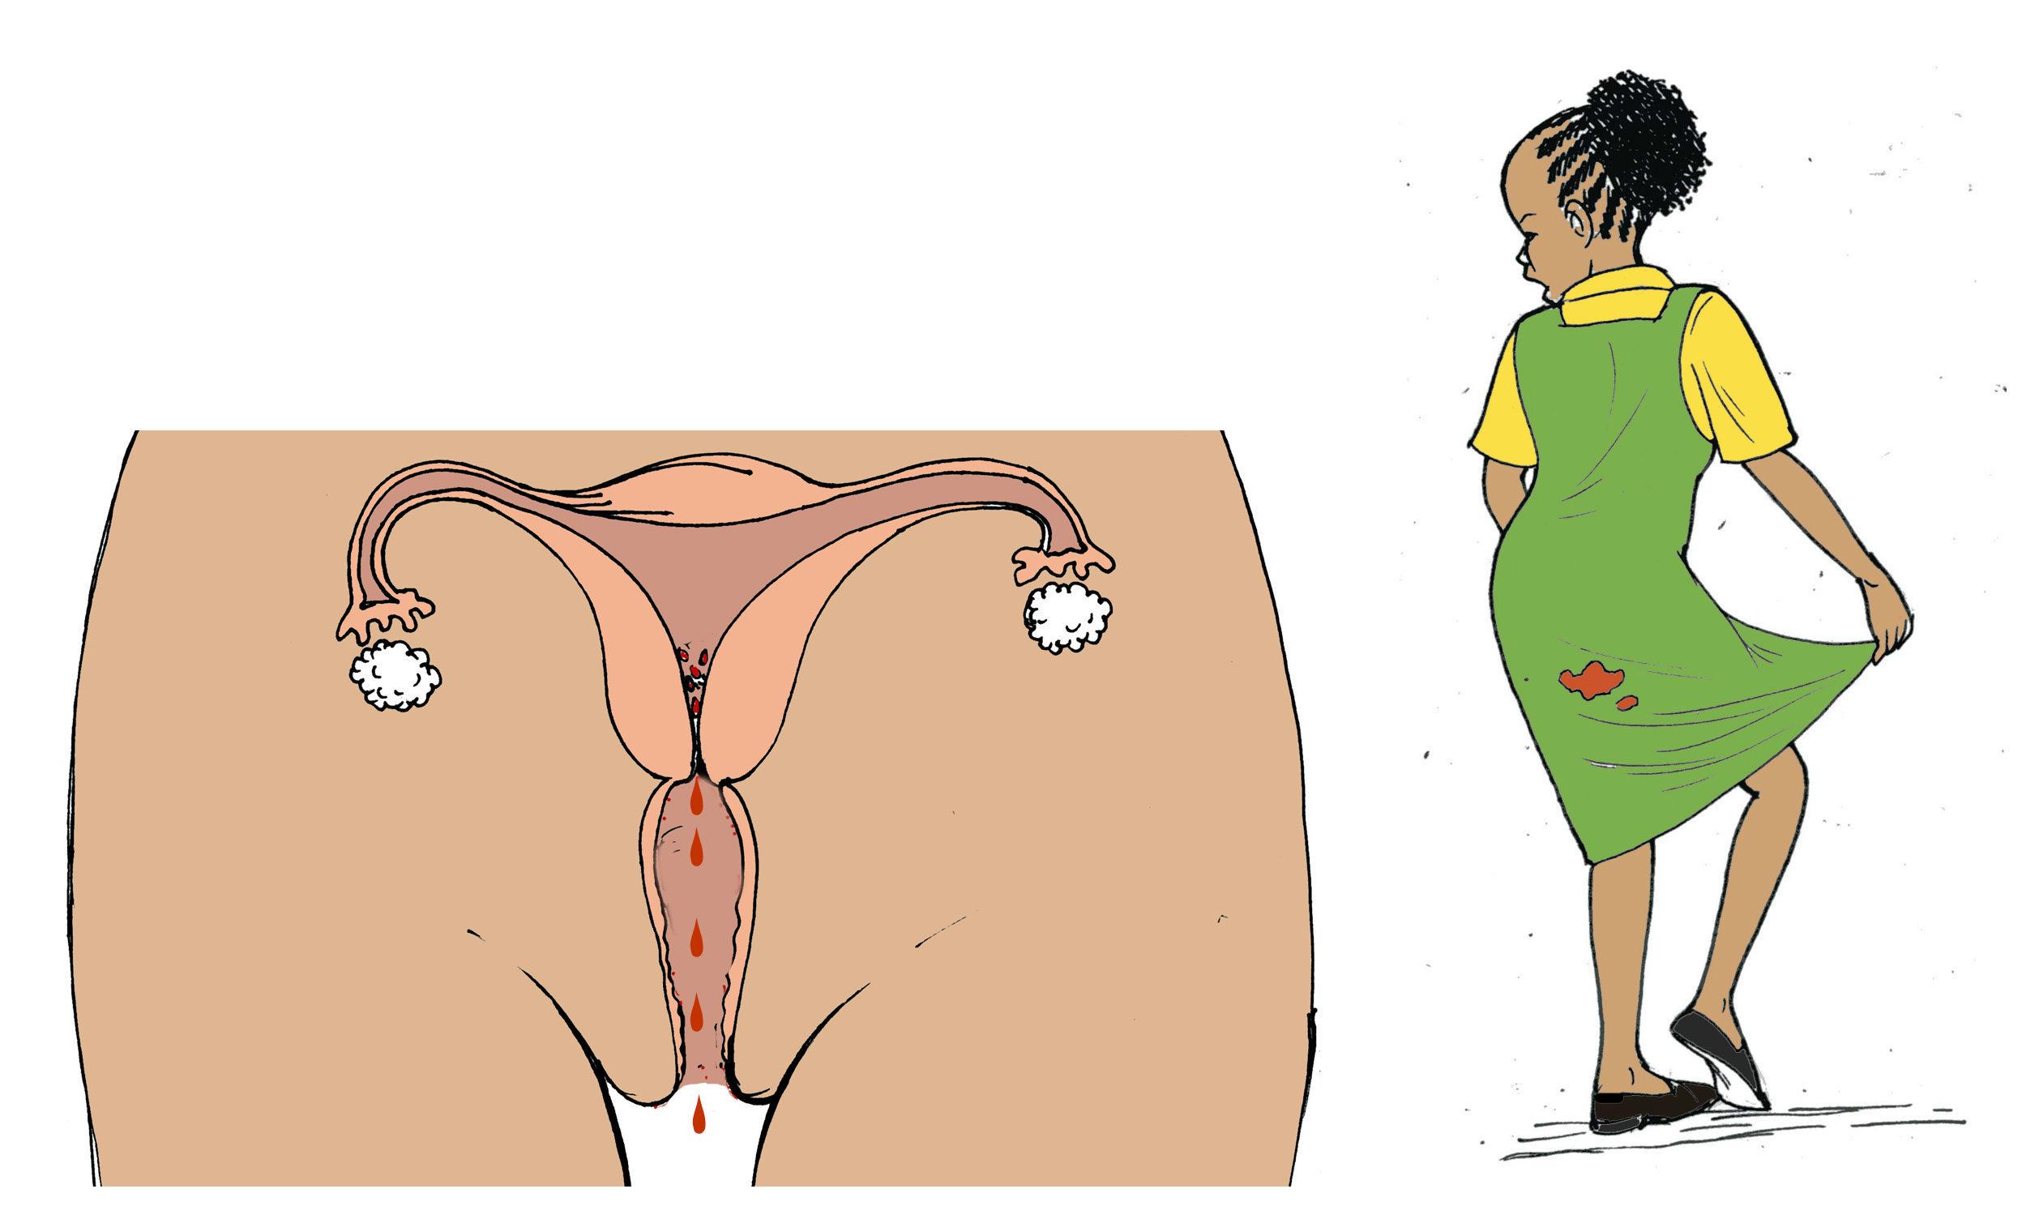
Menstruation
If the egg does not encounter any sperm, the uterus will shed the egg and the inner lining of the uterus. This bleeding and occasional clots is what is called menses, or your period
Most females will release an egg and bleed every month (every 4 weeks)
However, adolescents often have irregular cycles for the first few years. Some girls bleed every 2-3 weeks, while others may bleed only 3-5 times a year

Slide 5
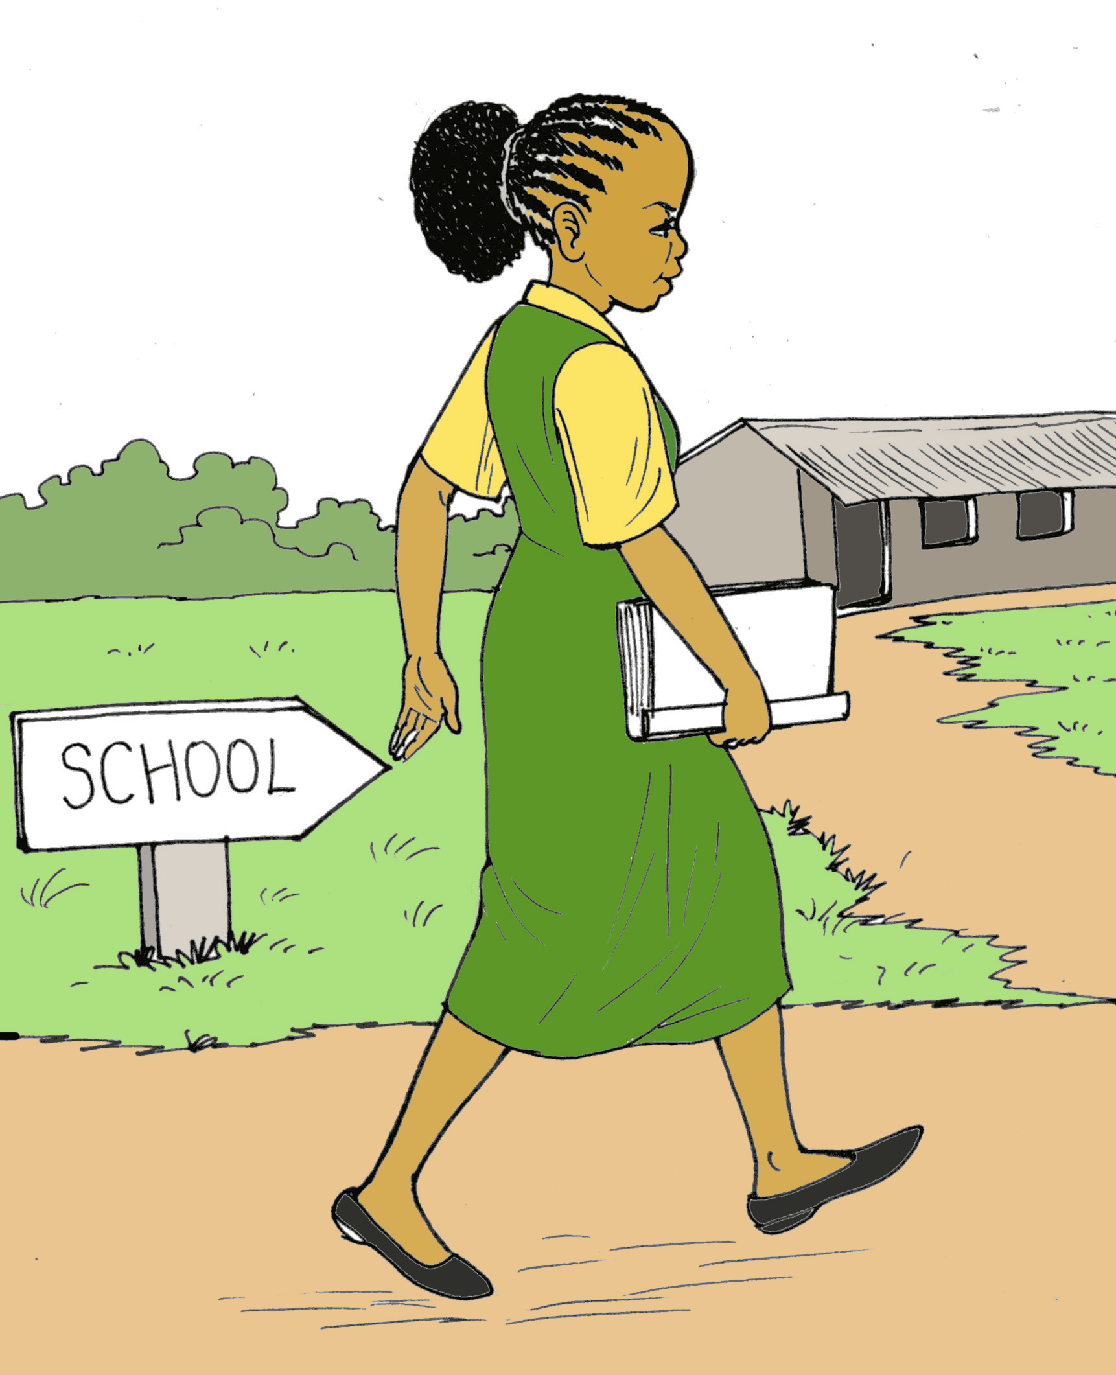
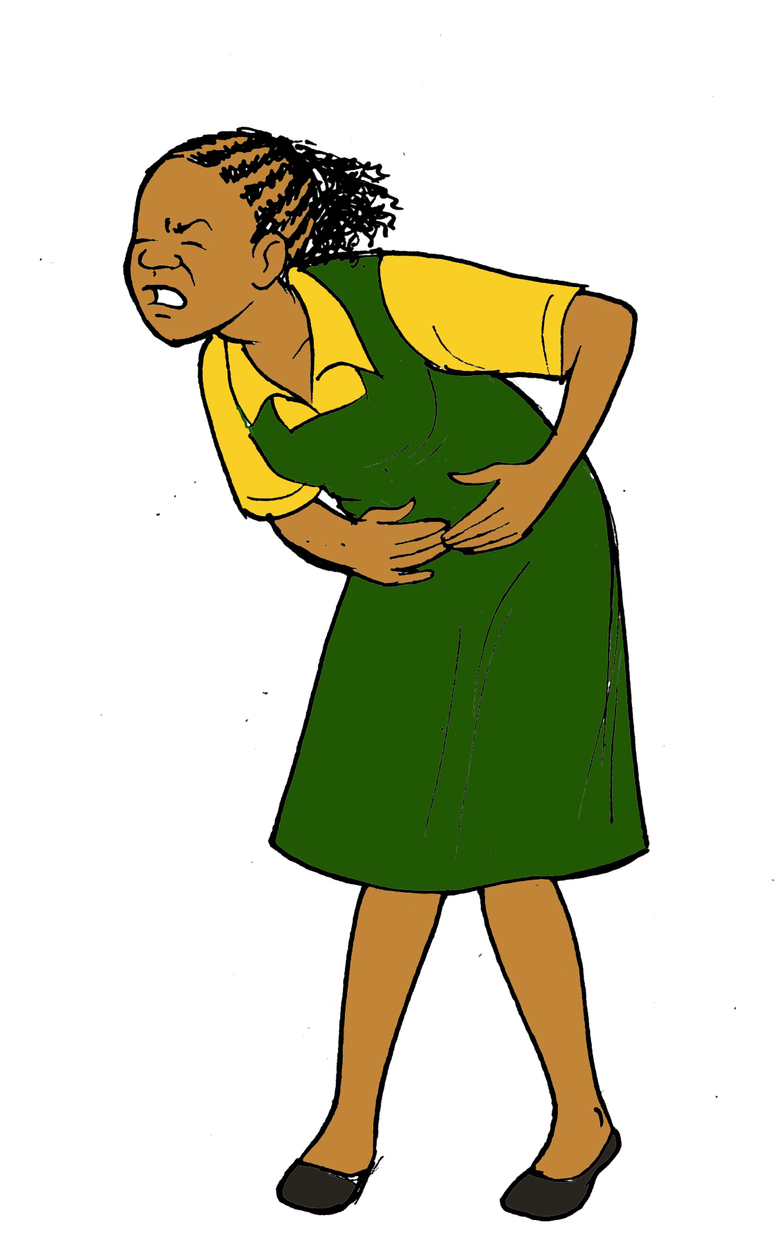
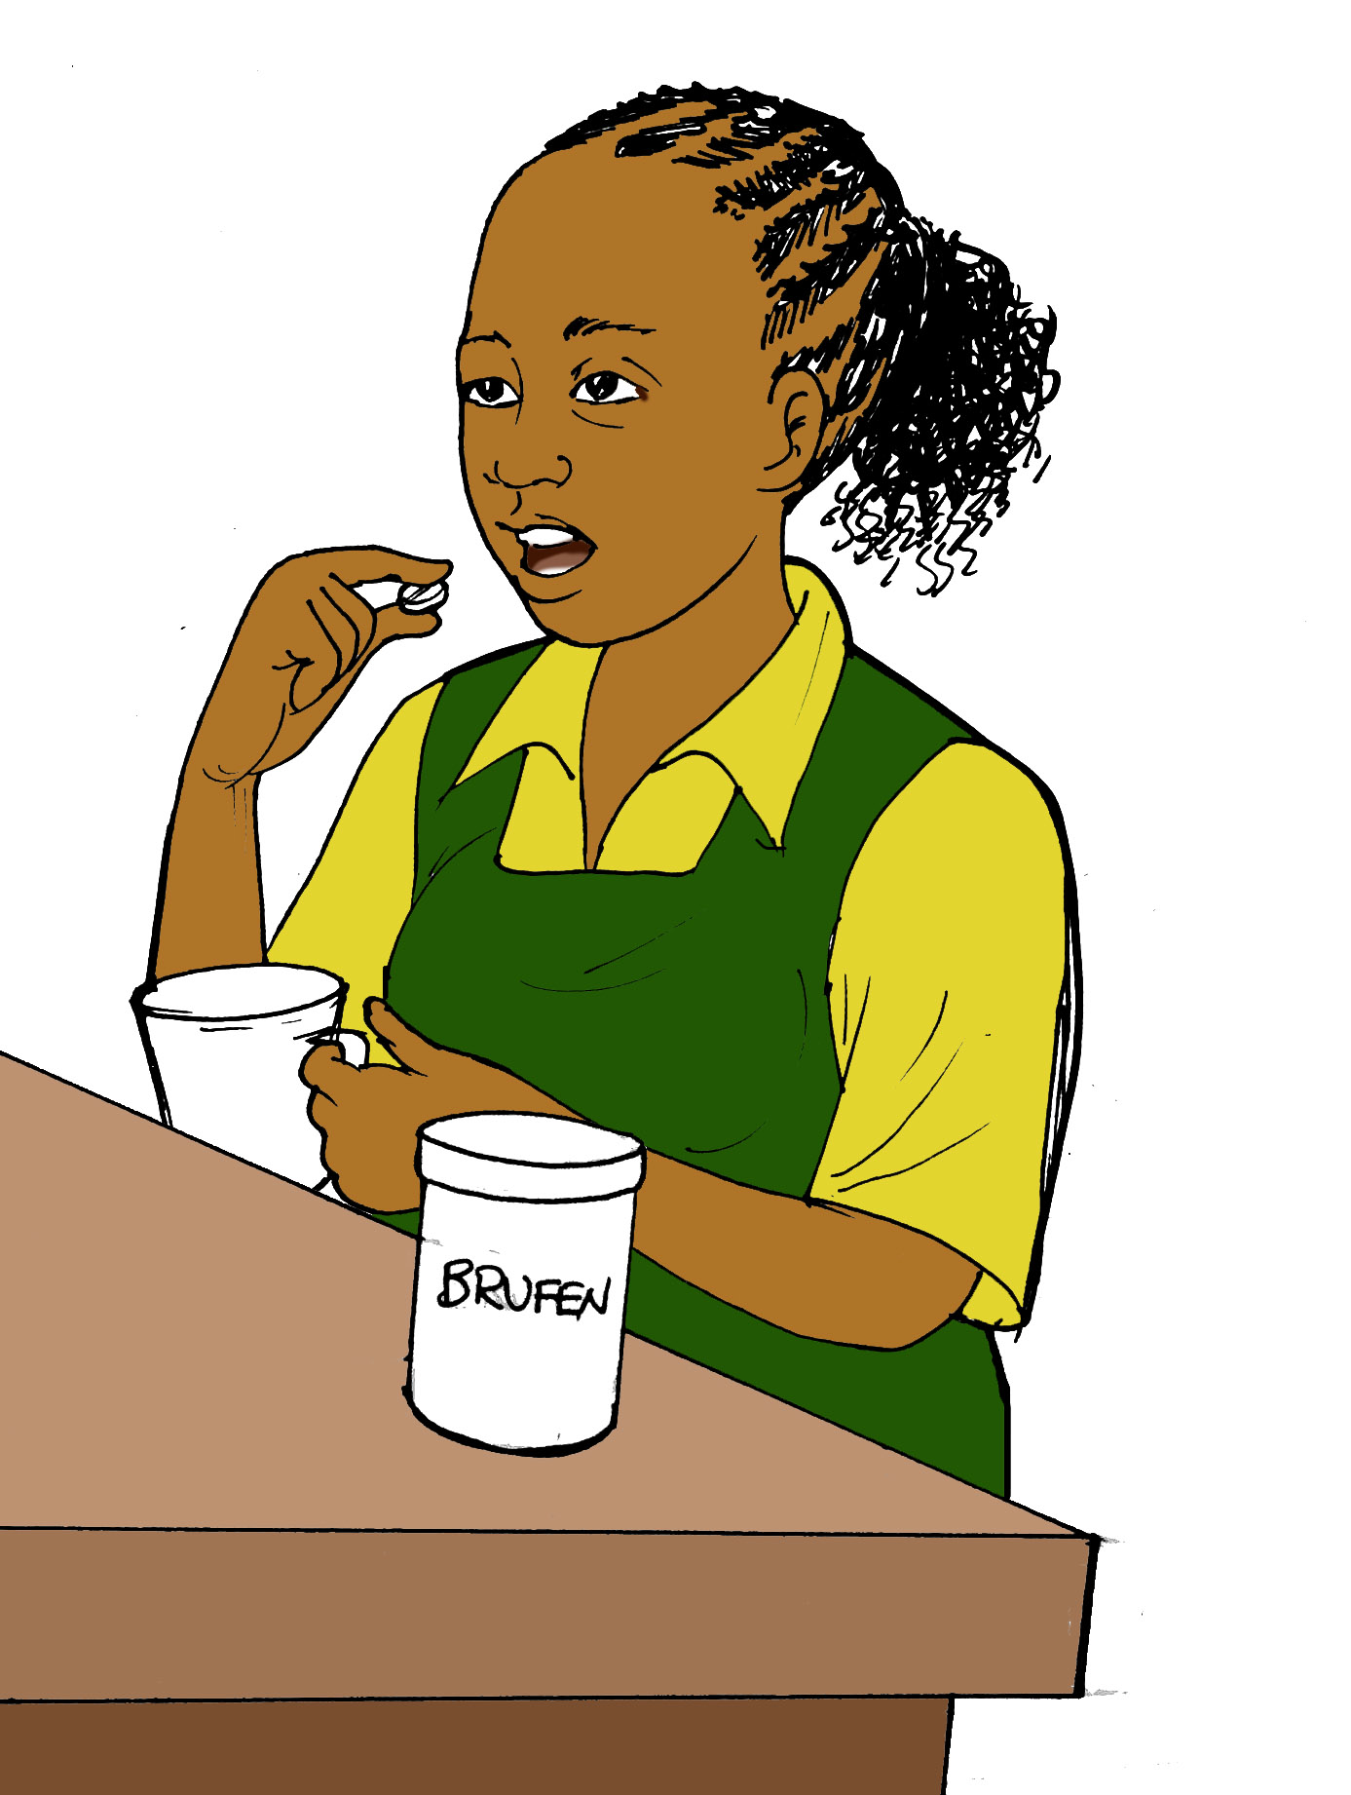
Menstruation
Right before or during menstruation, you can have significant abdominal cramping, nausea/vomiting backache, and become very emotional
If you are having cramps or backache, you can take brufen
If you are not having regular menstrual cycles, please talk to a healthcare provider
If you are bleeding too often or for too many days (7-10 days), you may be losing too much blood and may need a medication to help decrease the bleeding
Notes:
For training materials, include brufen dosing

Slide 6
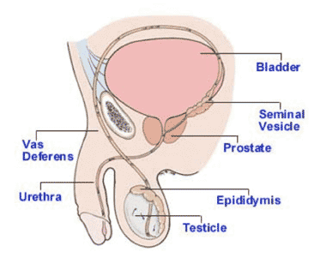
MALE reproductive system
Males develop sperm in their testes (testicle)
As the sperm travels to the penis, other fluids are added to form semen from other male organs such as seminal vesicles
During ejaculation, semen containing sperm travels through and is released through the urethra, the same tube that urine is released

Slide 7
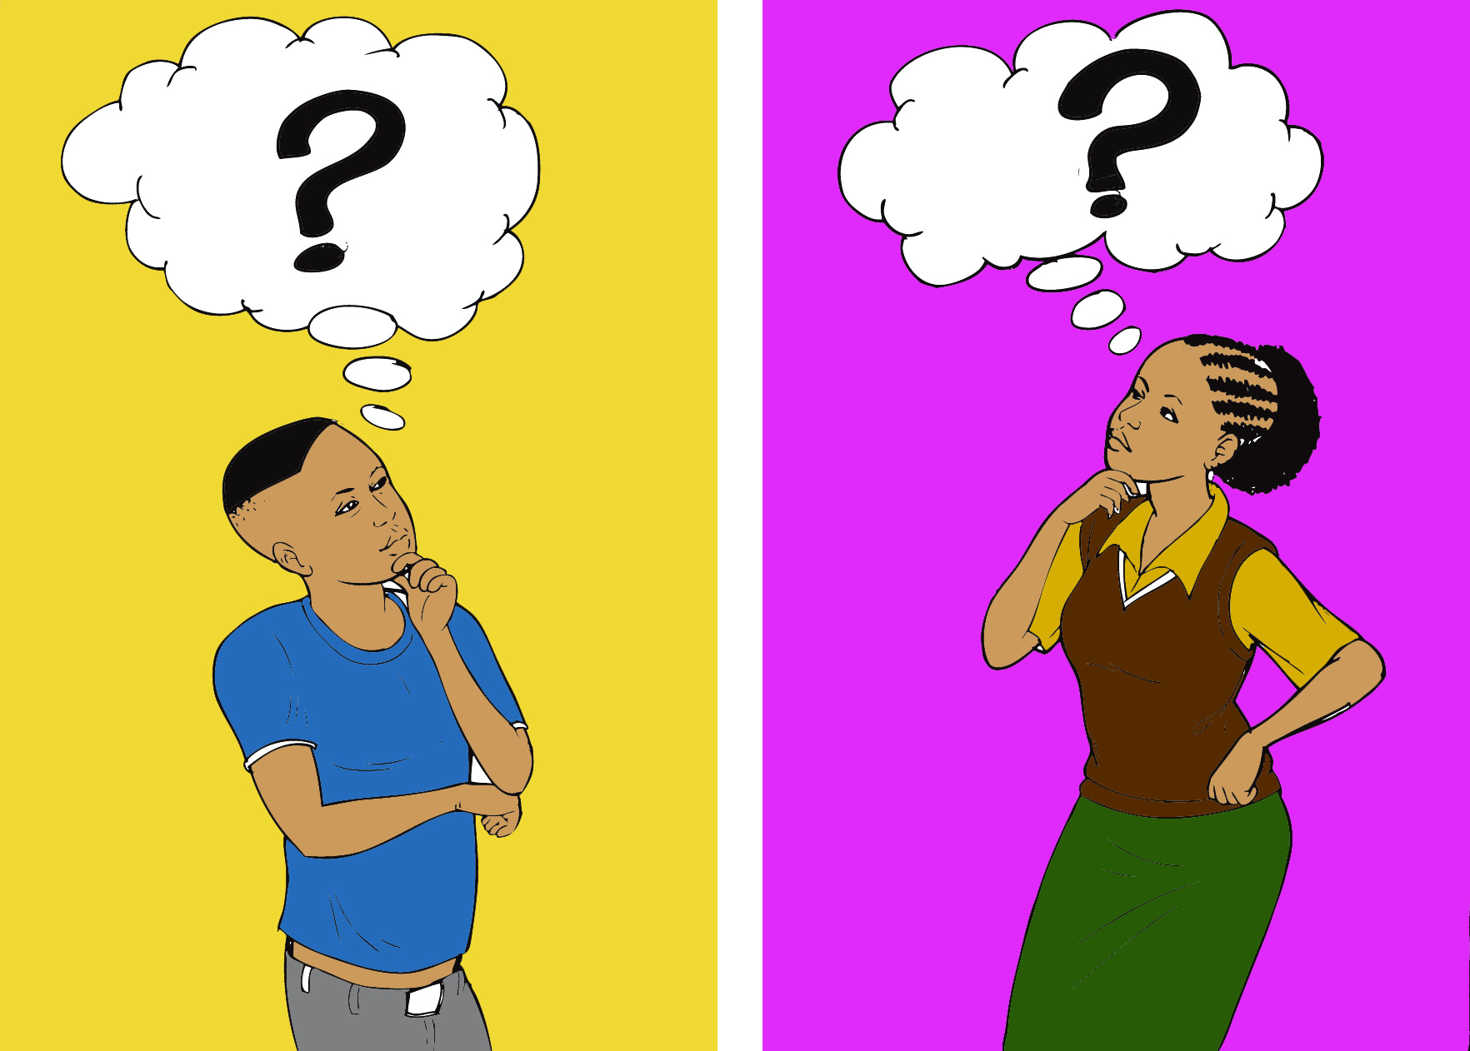
Decision-making
Each couple has to decide for themselves whether they are ready to have sex. No one has the right to force you to have sex ever
The decision to have sex has many consequences, including possible pregnancy, STIs, and transmission or re-infection with HIV or resistant HIV.
Talk with your partner about what you will do if you fall pregnant, get an STI, etc.
How would these consequences affect you and align with your life goals?
Abstinence is the best way to protect yourself from STI and pregnancy.
You should talk about HIV status of you and your partner. If you don’t feel comfortable talking with this person about your HIV status, are you sure you want to have sex with them?

Slide 8
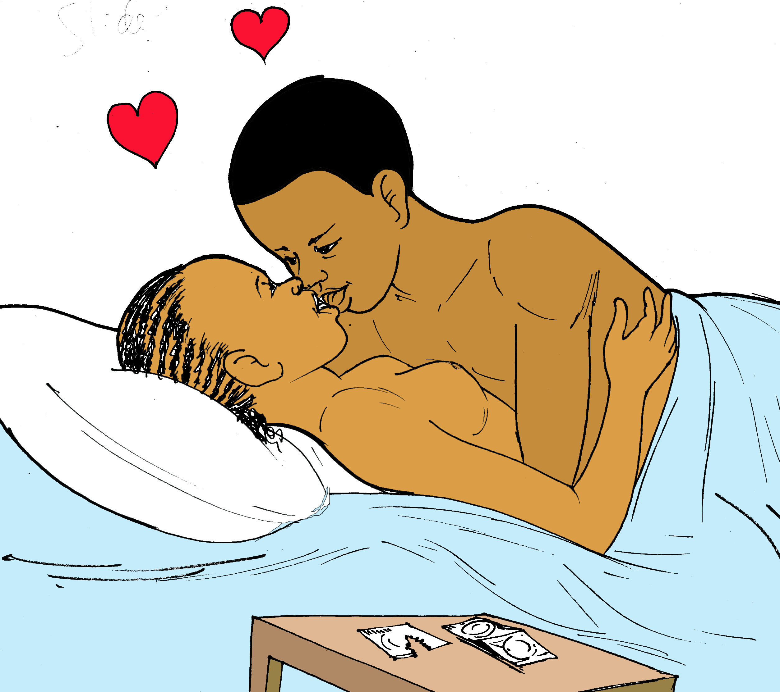
Basics of sex
Sex can refer to gender (male or female)
Sex is also an act between 2 people where their genitals come into contact with either the other person’s genitals (vaginal sex), anus (anal sex) or mouth (oral sex)
The most common form of sex is vaginal sex, where a man’s erect penis enters the woman’s vagina
During sex, a man ejaculates a fluid that contains sperm

Slide 9
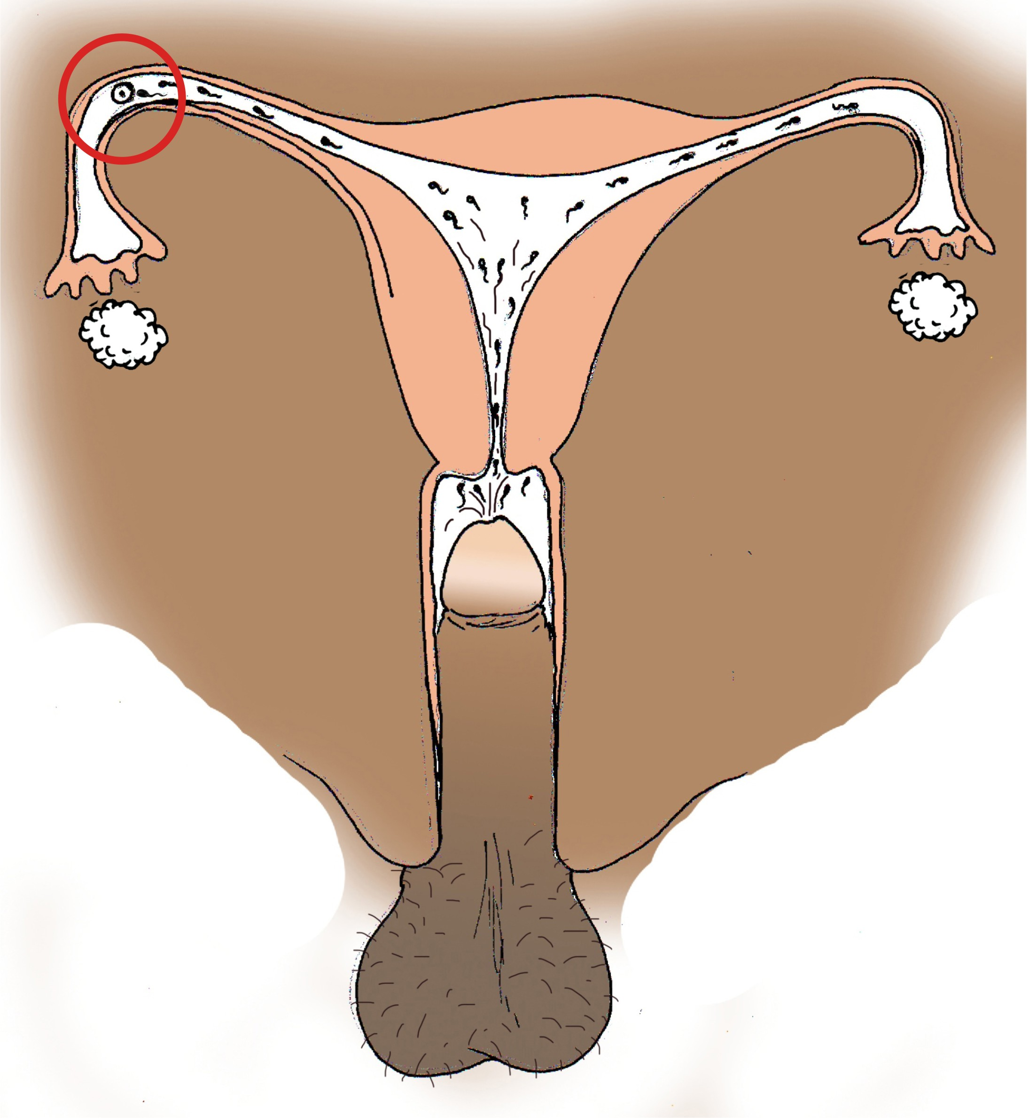
Basics of pregnancy
A woman can become pregnant after she has unprotected sex. The sperm released from the man’s penis during sex swims up through the woman’s vagina and cervix and uterus and comes into contact with an egg
Once the egg and sperm have joined together, they form an embryo, which attaches to the inside of your uterus and starts growing into a baby
Notes:
Make sure the illustration shows the fertilization in the fallopian tube

Slide 10
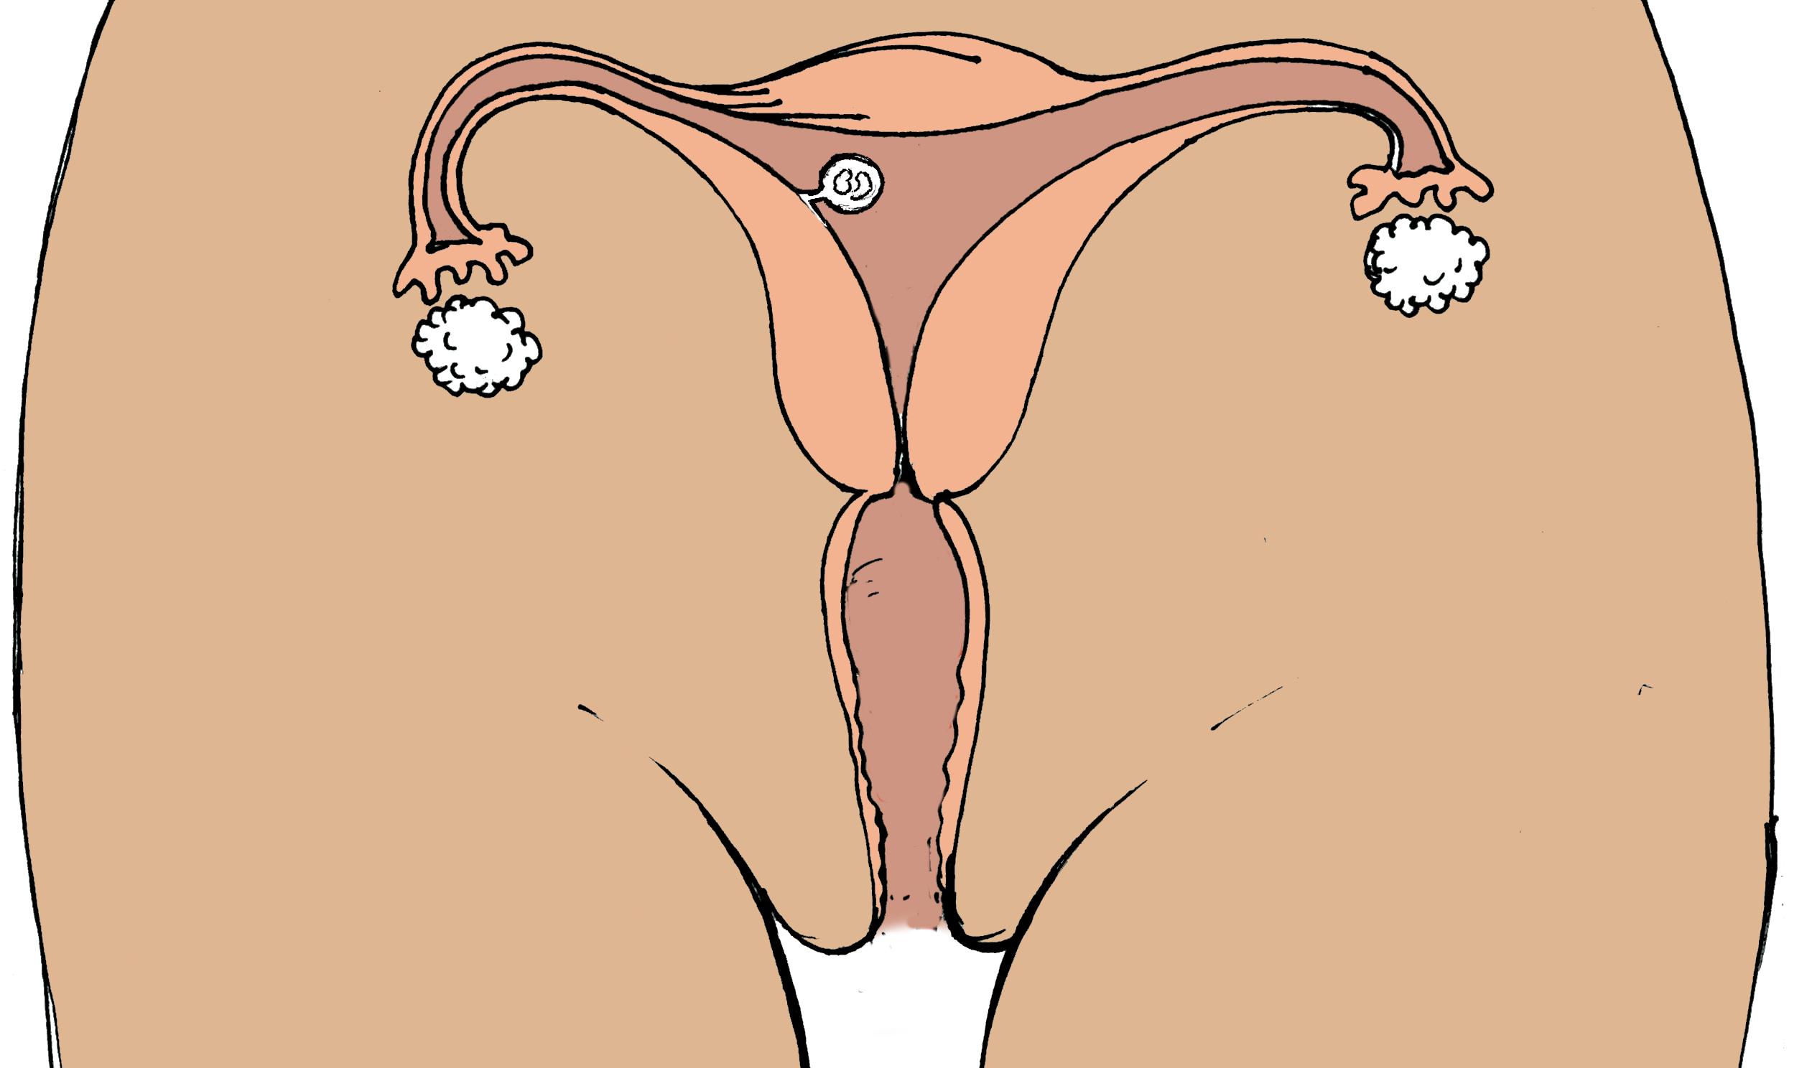
pregnancy
Because the embryo is attached to the uterus, your body will not shed the lining and you will not bleed (you will miss your period). This is the first sign of pregnancy
It takes 9 months for the baby to grow
If you’ve had sex and miss a period, it is possible that you may be pregnant
Please talk to a healthcare provider immediately if you miss your periods or think you may be pregnant to ensure the health of yourself and the growing baby

Slide 11
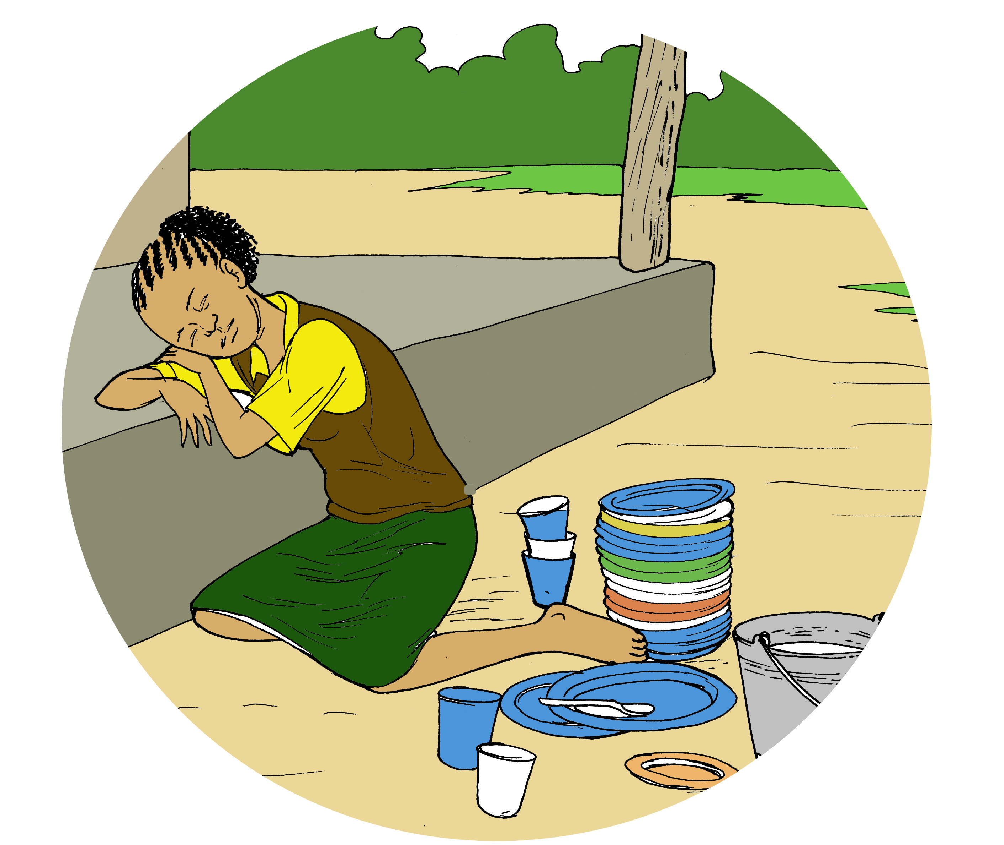
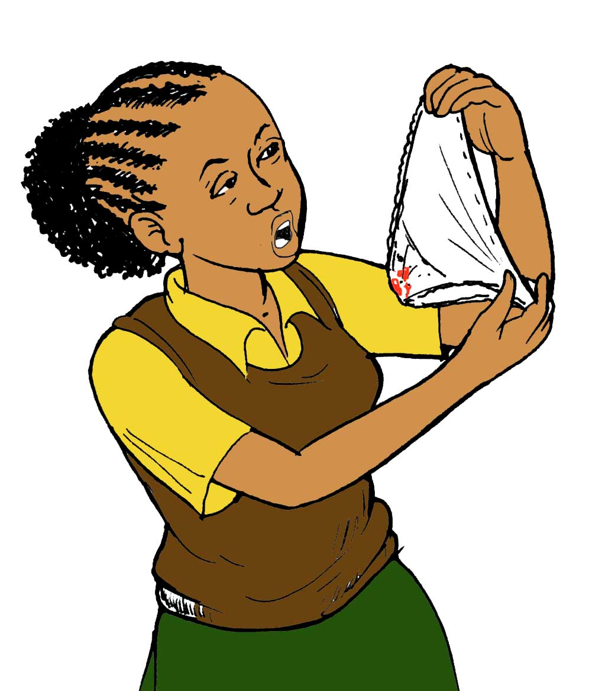
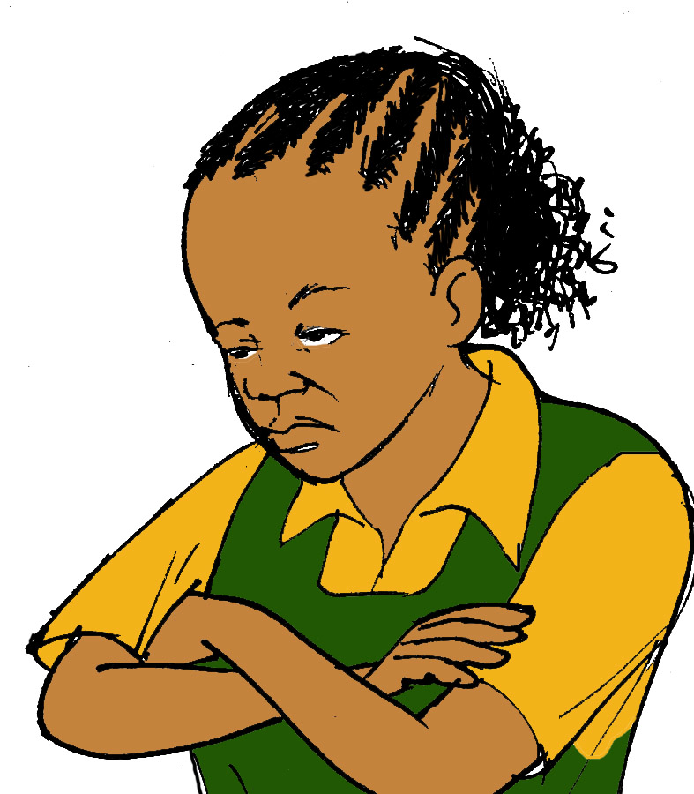
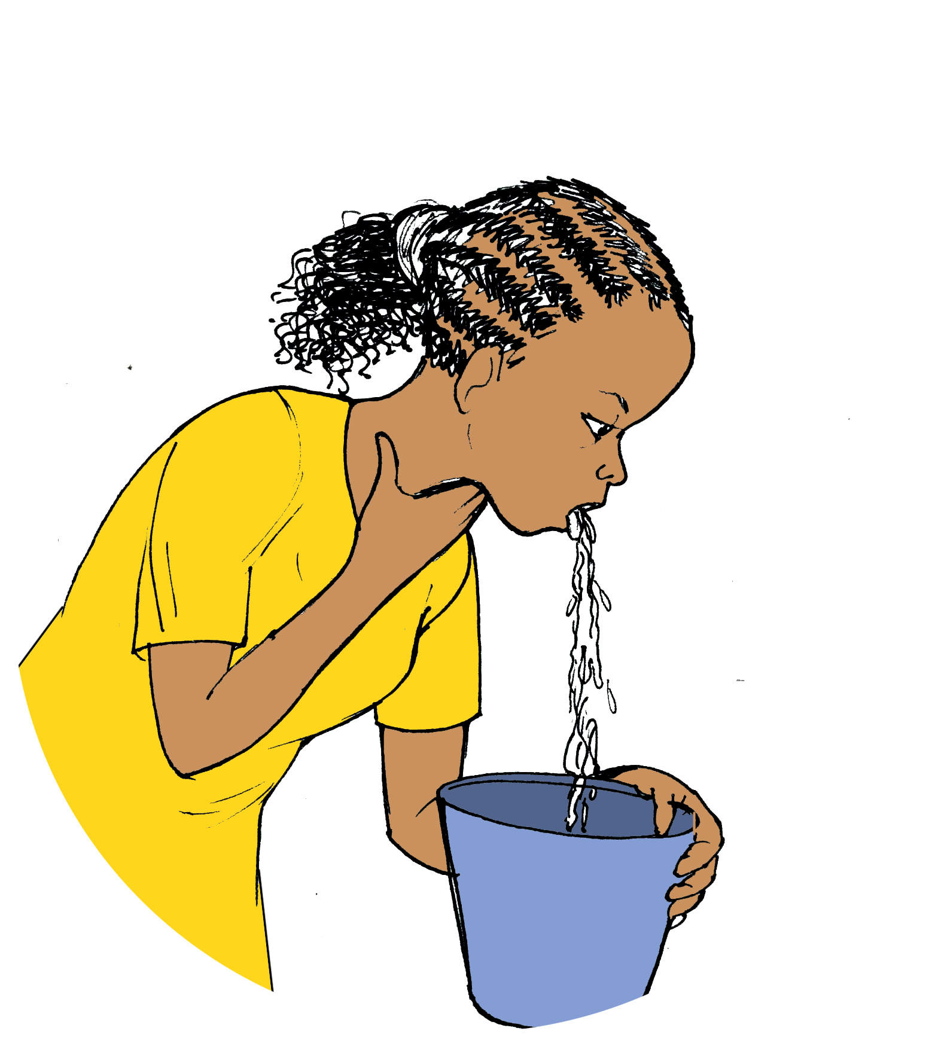
Signs of pregnancy
Other signs of pregnancy other than missing your period include:
Fatigue
Nausea/ vomiting
Increased urinary frequency
Breast tenderness and enlargement
Bloating or cramping
Spotting (small amounts of blood from your vagina, less than your usual period)
Mood changes
Some people don’t experience any of these signs

Slide 12
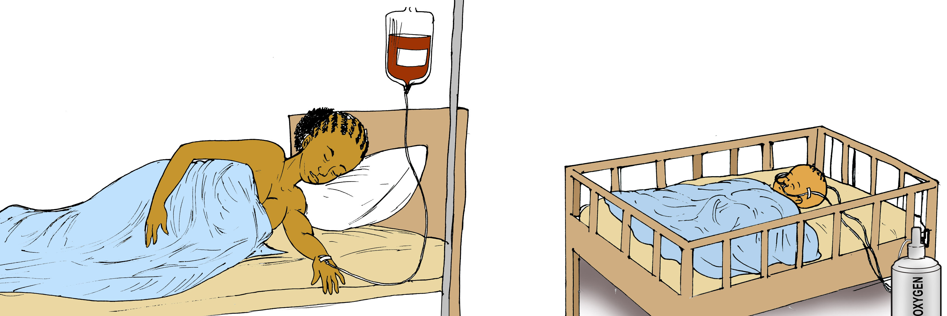
Teen pregnancy
Becoming pregnant while you are still a teenager can be dangerous. Both mom and baby are at risk of becoming very sick or dying during the pregnancy and/or delivery
Because teens are still growing, often the pelvis of a teenager is not yet big enough for the baby’s head to fit through. This can cause problems with delivery
There can be too much bleeding in the mother (anemia) or damage to the mother’s vagina that can cause fistula (leaking urine). The baby may also not get enough oxygen for breathing
You can prevent becoming pregnant until your body is ready by not having sex, or using contraception if you do have sex

Slide 13
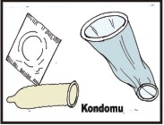
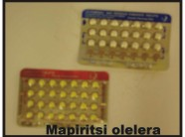
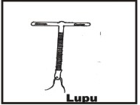
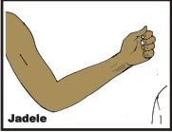
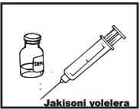
contraception
All of the methods of contraception in this book can be used by an HIV-infected or uninfected female to prevent pregnancy
Any female can use almost all of these types of contraception, whether they have had a baby or not. The only exception is sterilization, which is permanent and shouldn’t be used by adolescents who have not had children yet

Slide 14
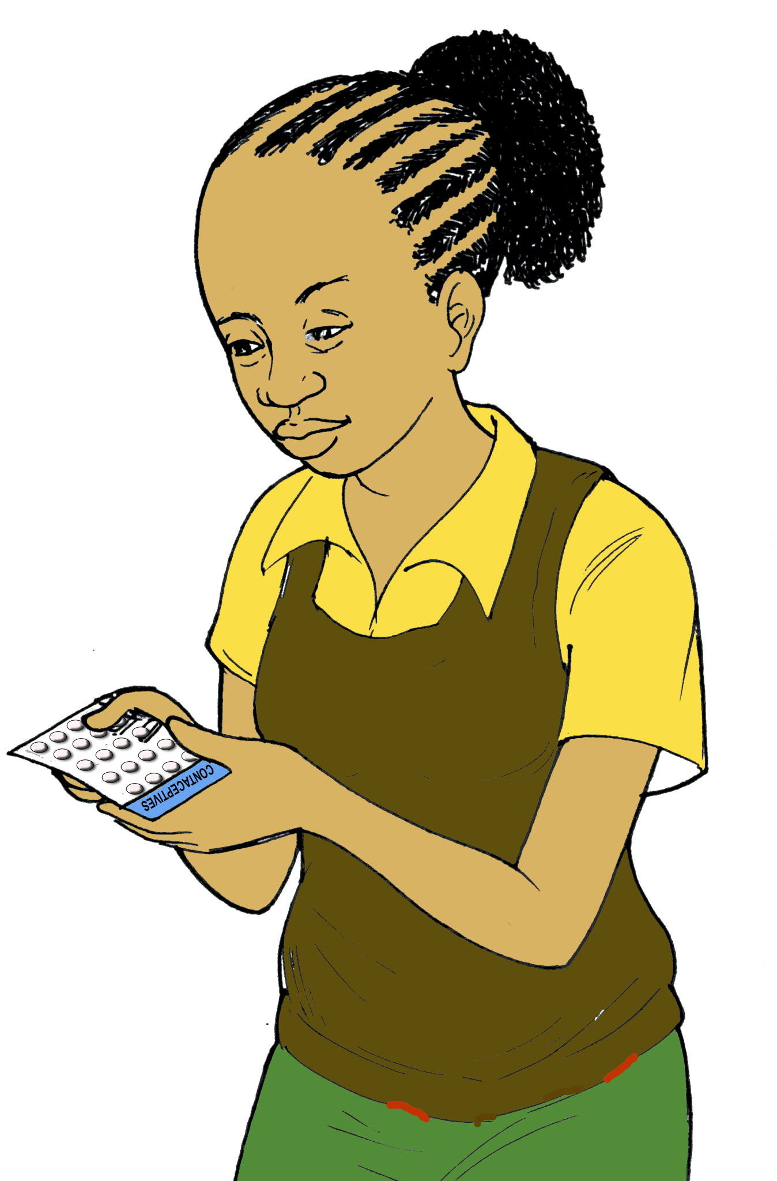
Other Advantages of contraception
Did you know?
Even if you are not yet sexually active, contraception can help regulate your periods. This is helpful if you have heavy bleeding, skip months, have very painful menstrual cramps, or bleed too often during your cycles
Some forms of contraception also prevent problems such as ovarian cysts
Notes:
Illustrator: have another section with her walking to school looking happy

Slide 15
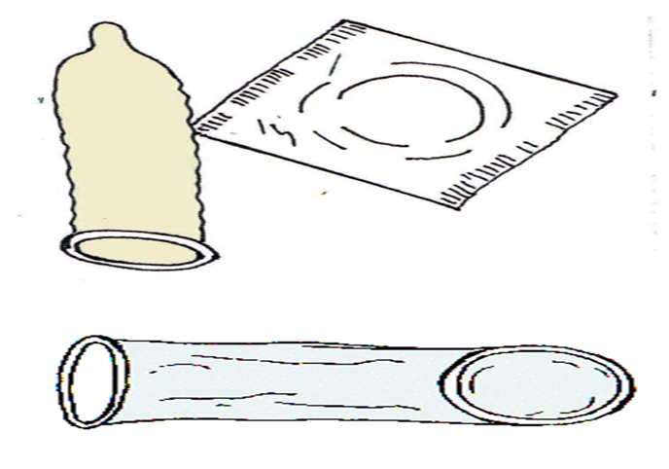
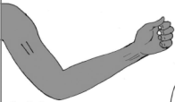
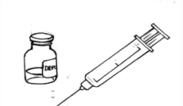
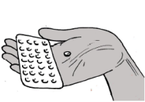
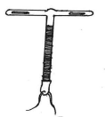
DUAL METHOD CONTRACEPTION:
The use of condoms in addition to a second form of contraceptive (usually injection, implant, IUCD, or pill)
DUAL
METHOD
CONTRACEPTION
Prevention against HIV infection, STIs, and pregnancy
CONDOM
ADDITIONAL CONTRACEPTIVE

Slide 16
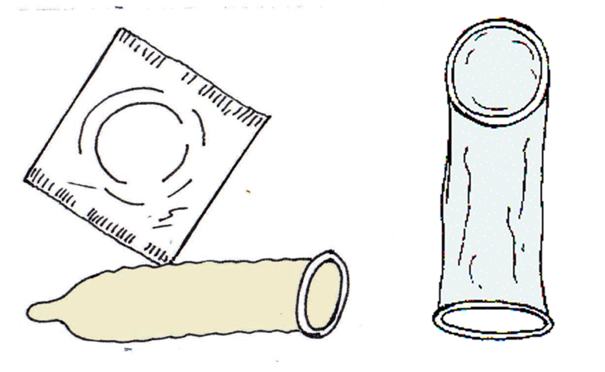
CONDOMS
Two different types: Male and Female

Slide 17
condom
Creates a barrier between two people that prevents HIV and other STIs from passing from one person to the next during sexual intercourse
Can only use one at a time
Can only be used once, then must be discarded
Most effective if used correctly and every time when having sex
Should be used with another form of contraceptive
ADVANTAGES | DISADVANTAGES
Prevents against HIV | Can only be used once
Prevents sexually transmitted infections (STIs) | They can break and be ineffective
Prevents pregnancy | Latex can cause a rash in some people
Effectiveness for pregnancy prevention: 18-21 pregnancies in 100 women each year using this method
DISPELLING MYTHS
Does not make men impotent, weak, or decrease sex drive
Cannot get lost in a woman’s body
Are not laced with HIV or have small holes through which HIV can pass
Does not cause sperm to “back up”
Circumcised men still need to use condoms

Slide 18
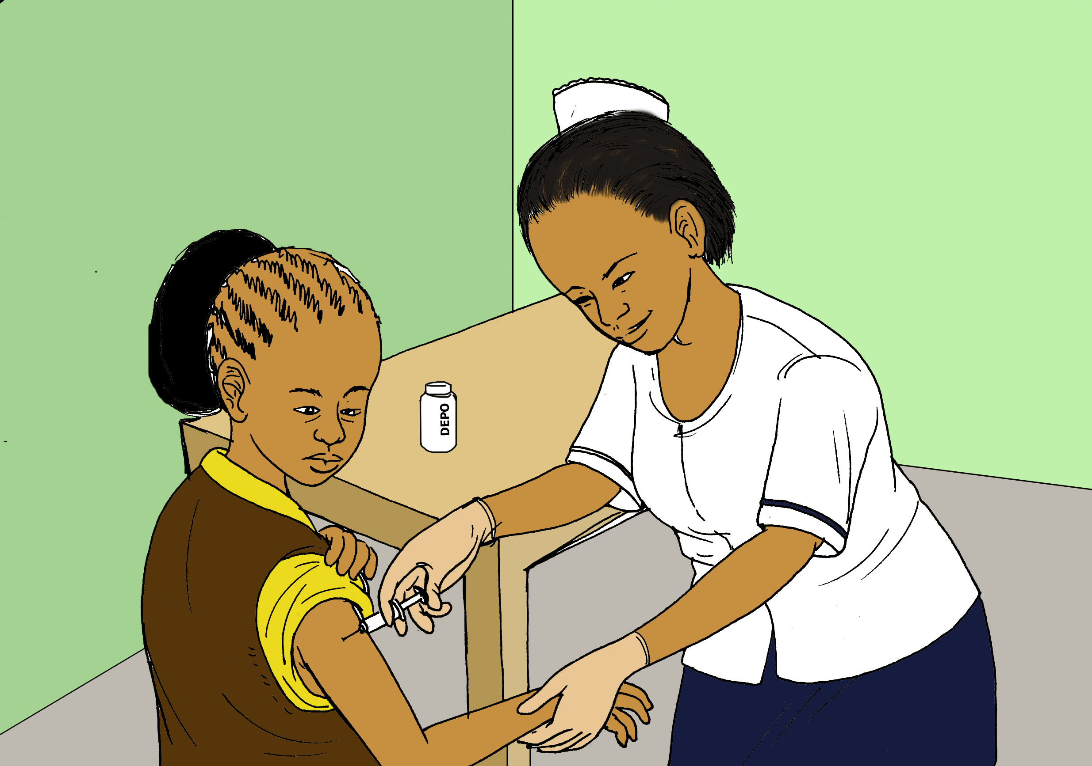
Injectable hormones
“Depo”

Slide 19
Injectable hormones
Depo-Provera (Depo) is an injection given every three months
Depo can cause spotting or irregular cycles, especially after the first injection. This usually improves after the second injection three months later
After you stop using Depo, it may take up to one year to return to a regular menstruation cycle or become pregnant
Can cause weight gain
ADVANTAGES | DISADVANTAGES
Only requires one injection every 3 months | Does not protect against HIV or STIs
Nobody will know if you are using this method | May cause abnormal vaginal bleeding or no bleeding at all
No interaction with ARVs | May cause weight gain
Effectiveness for pregnancy prevention: 6 pregnancies in 100 women each year using this method
DISPELLING MYTHS
Blood does not build up inside the woman
Does not disrupt an existing pregnancy
Does not make women infertile
Does not cause early menopause
Does not cause birth defects or multiple births
Does not change women’s sexual behavior
Don’t rub the skin after injection

Slide 20
Oral contraceptives

Slide 21
Oral contraceptives
Should be taken daily at the same time
Different kinds
Progestin only pills: can be taken during breastfeeding
Combined hormones
ADVANTAGES | DISADVANTAGES
Can be stopped at any time | Must be taken daily
Controlled by the woman | Does not protect against STIs
Does not interfere with sex | Missed dose can lead to increased chance of pregnancy
Bleeding is decreased but normal cycles continue | Concerns about effectiveness when used with ART
Effectiveness for pregnancy prevention: 9 pregnancies in 100 women each year using this method
DISPELLING MYTHS
Does not “build up” in a woman’s body
Must be taken every day regardless of sexual activity
Does not make women infertile
Does not change women’s sexual behavior
Will not disrupt existing pregnancy

Slide 22
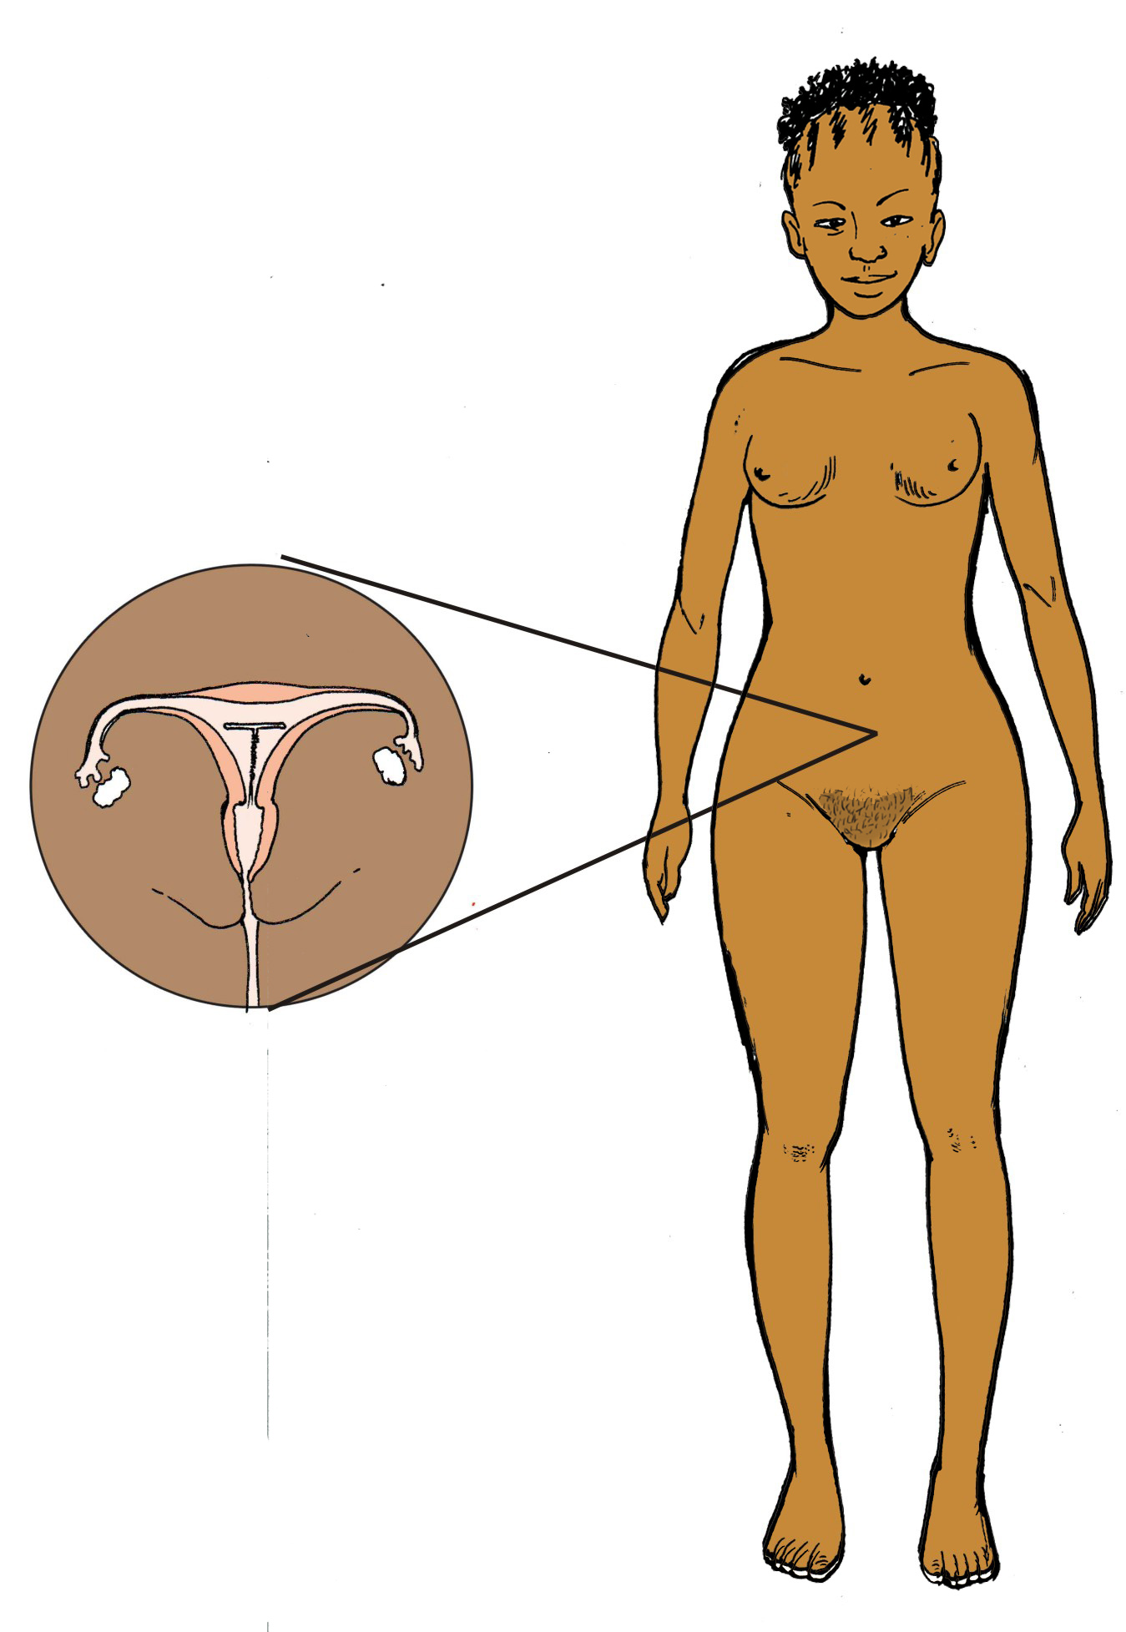
IuCd or loop

Slide 23
IUCD or loop
IUCD= intrauterine contraceptive device
Non-hormonal T-shaped device inserted into the uterus
Requires a quick procedure done by a nurse or clinician
ADVANTAGES | DISADVANTAGES
Lasts 5-12 years | Does not protect against HIV or STIs
Very effective | Requires insertion into uterus
Nothing to remember | Abdominal cramping and bleeding for first few months
Effectiveness for pregnancy prevention: Less than 1 pregnancy in 100 women each year using this method
DISPELLING MYTHS
Rarely leads to infection
Does not increase risk of contracting STIs
Does not make women infertile
Does not cause birth defects
Does not cause cancer
Does not move out of uterus to the heart or other parts of the body
Does not cause discomfort during sex

Slide 24
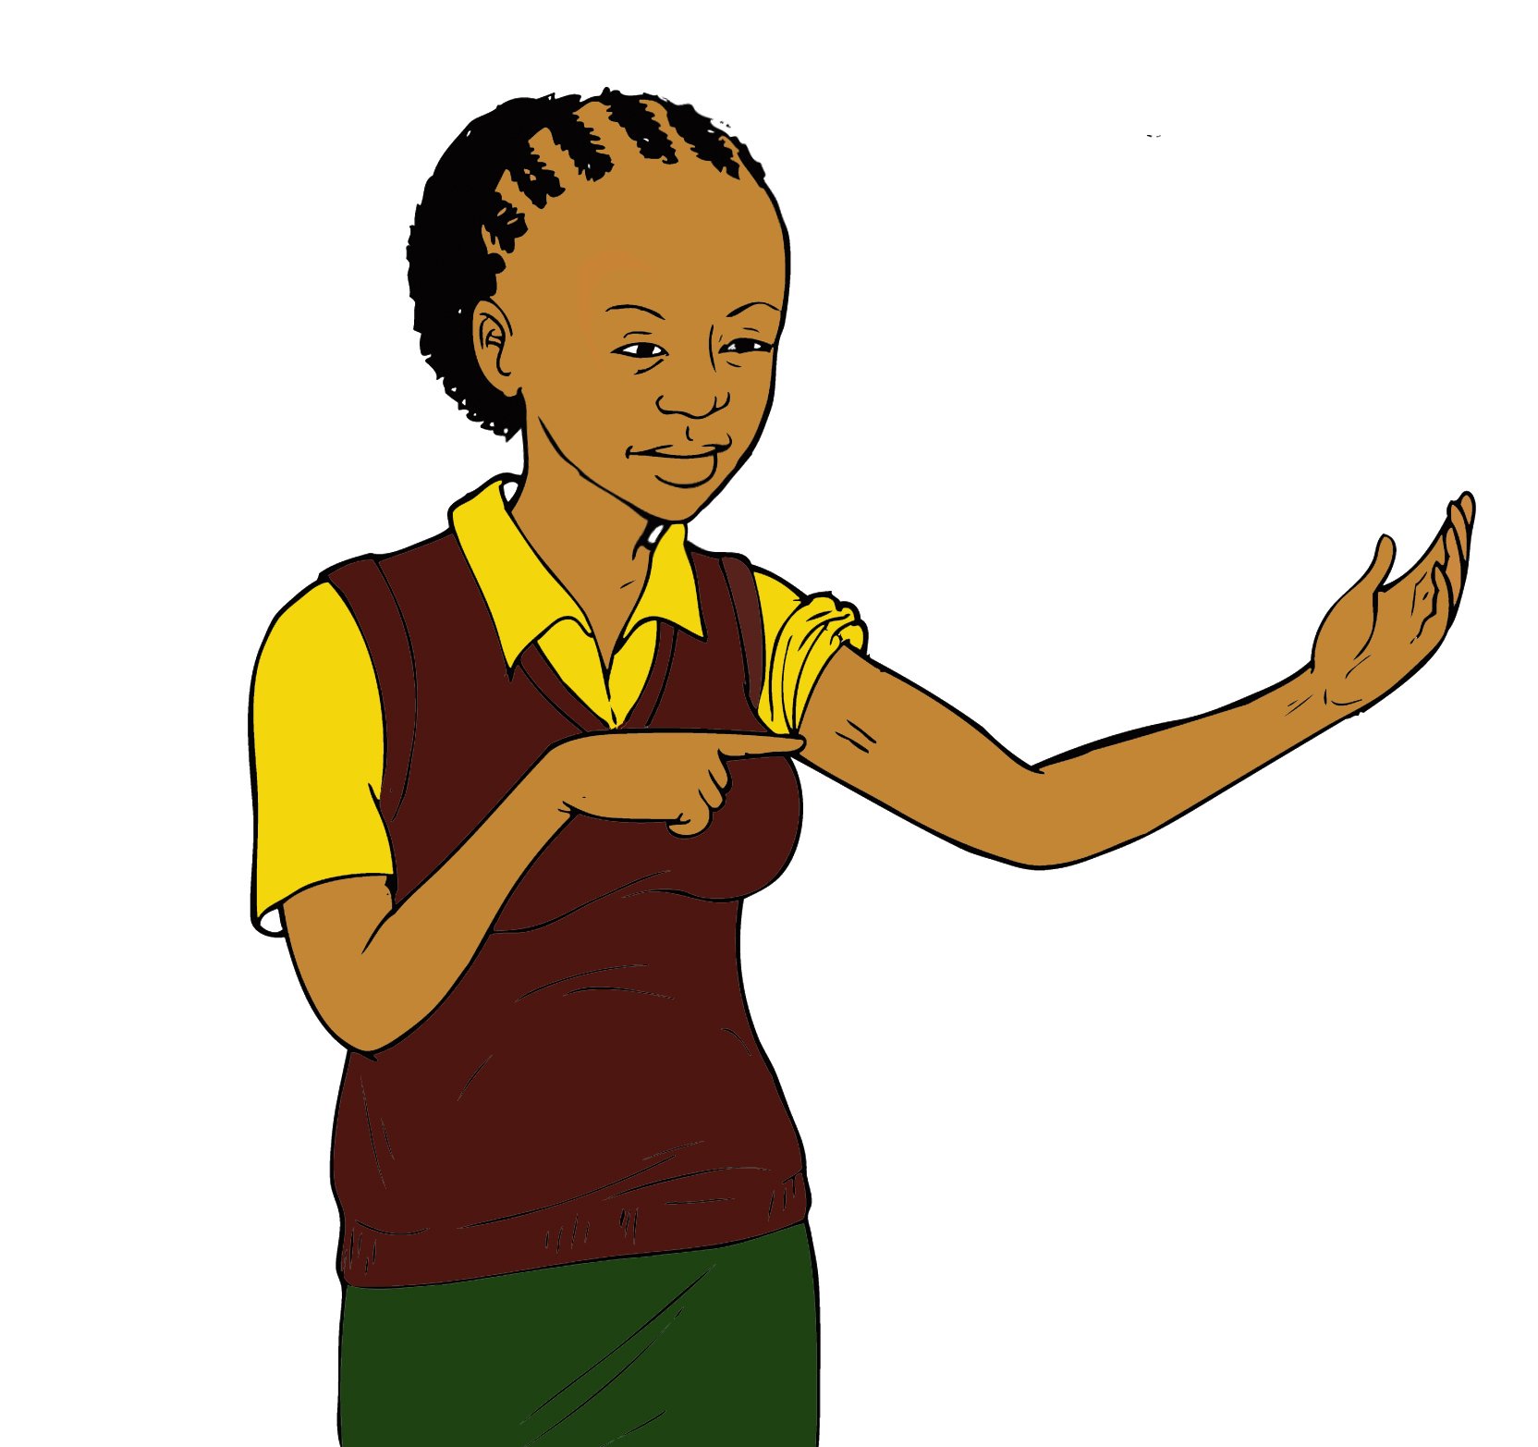
implant
Jadelle, Norplant, Implanon

Slide 25
implant
JADELLE, IMPLANON, NORPLANT
Small capsules inserted into the upper arm of a woman by an experience clinician
Releases hormones over time
ADVANTAGES | DISADVANTAGES
Effective up to 5 years | Does not protect against HIV or STIs
Does not interfere with sex | May cause abnormal vaginal bleeding
Nothing to remember | Requires a minor procedure
Bleeding is decreased | Effectiveness slightly reduced on ART- needs early removal
Effectiveness for pregnancy prevention: Less than 1 pregnancy in 100 women each year using this method
DISPELLING MYTHS
Hormones do not remain in the woman’s body, it stops working once it is removed
Blood does not build up in the woman when/if it stops monthly bleeding
Does not move to other parts of the body
Does not make a woman infertile
Does not cause chest pain
Don’t use in epileptics and those on TB medications

Slide 26
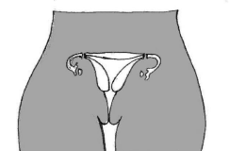
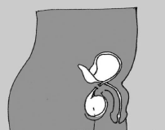
sterilization
FEMALE
MALE

Slide 27
STERILIZATION
Two types
Male: vasectomy (cuts vas deferens)
Female: tubal sterilization (cuts fallopian tubes)
Procedure must be done by an experience clinician
Long-term (for women who finished having children)
Not appropriate for adolescents
DISPELLING MYTHS
Does not change the sex drive
Does not change a man’s sexual function- erections are the same
Does not remove the woman’s uterus or the man’s testicles
Does not cause change in weight, appearance or appetite
Does not prevent transmission of HIV
Does not change a woman’s menstrual cycle

Slide 28

Natural methods
You may have heard of the following “natural methods” of birth control. These are NOT EFFECTIVE, especially in adolescents, since their menstrual cycles are often irregular
Mucous method
Withdrawal method
Calendar or BEADS METHOD

Slide 29
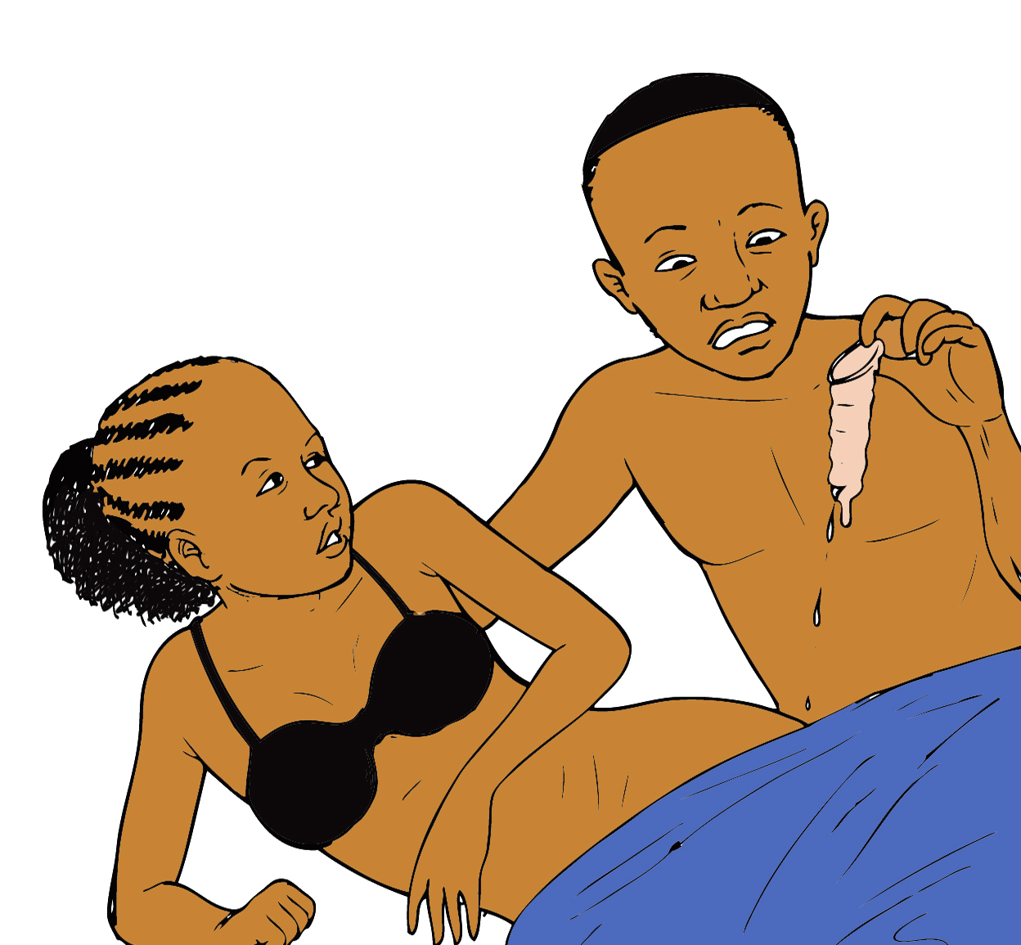
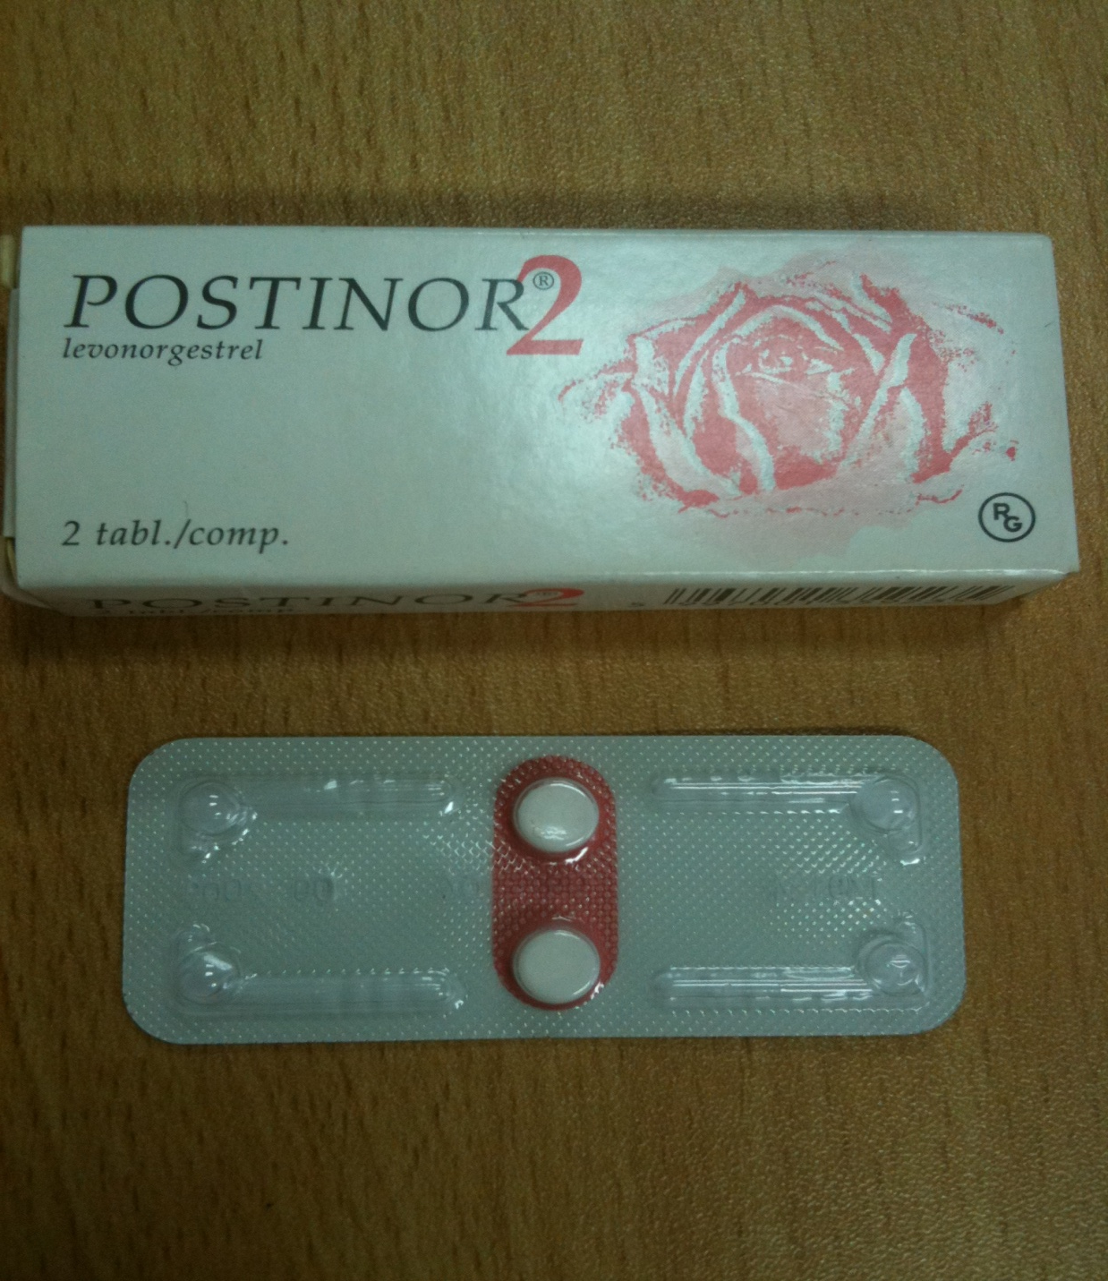
Emergency contraception

Slide 30
Emergency contraception
Should only be used in case of emergencies (condom breaking, rape, etc), not as a regular contraceptive
Most effective if taken as soon as possible after the incident, but can be taken within 5 days
Two doses taken- second dose taken 12 hours after the first dose
ADVANTAGES | DISADVANTAGES
Effective in case of emergencies | Does not protect against HIV or STIs
Can be taken in one day | Cannot be used as a regular contraception method
Effectiveness for pregnancy prevention: 99-98%
DISPELLING MYTHS
Does not prevent STIs or HIV transmission
If you are not HIV-infected, your should also take PEP (post-exposure prophylaxis) to prevent getting HIV
Does not cause an abortion
Does not cause birth defects to occur
Is not dangerous to a woman’s health
Does not promote sexual risk-taking
Does not make woman infertile

Slide 31
Accessing contraception
If you are interested in any of these forms of contraception, please speak with a healthcare provider to learn more
You can find contraception services at:
Government health centers
BLM (Banja La Msogolo)
FPAM (Family Planning Association of Malawi)
PSI (Population Services International)
Private clinics
Some CHAM/CCAP hospitals
Ask at your Teen Club
The choice to use contraception is yours. You do not need approval from your family or sexual partner. It is your body, and your right to protect it

Slide 32
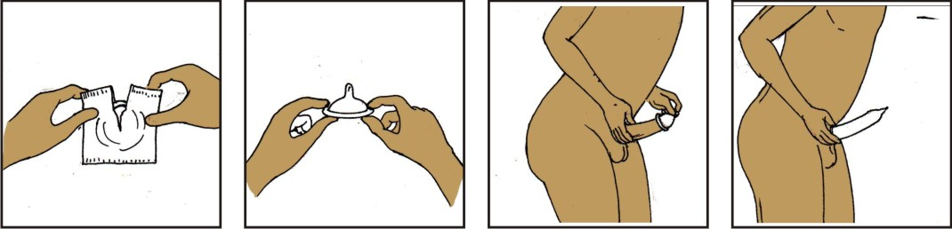

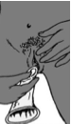
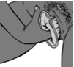
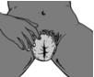
Sexually Transmitted infections
The only method of contraception that also protects against sexually transmitted infections (STIs) is CONDOMS
Several common STIs include:
Chlamydia
Gonorrhea
Human Papilloma Virus (genital warts)
Syphilis
Herpes
Trichomoniasis

Slide 33
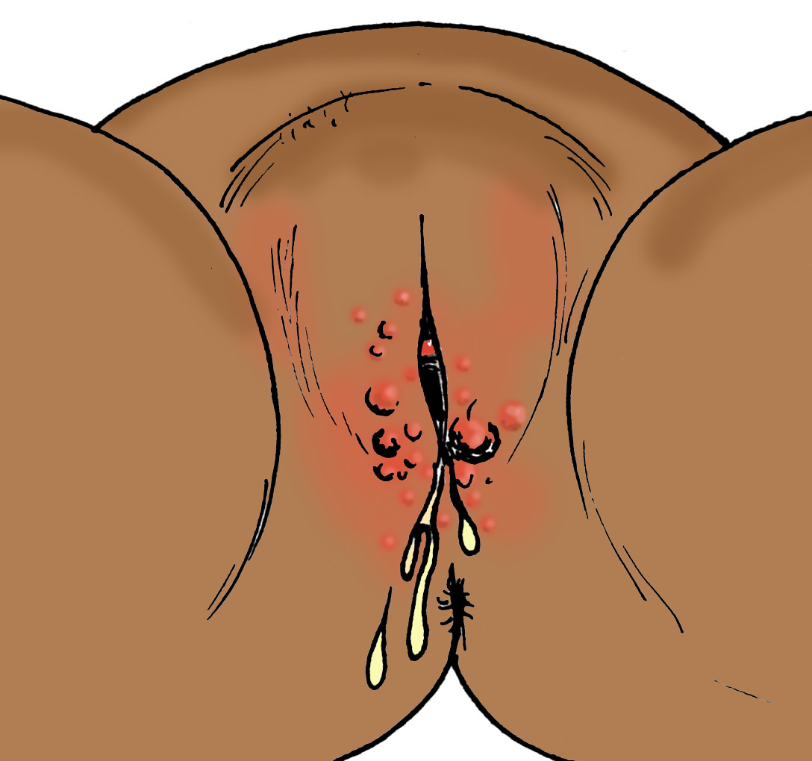
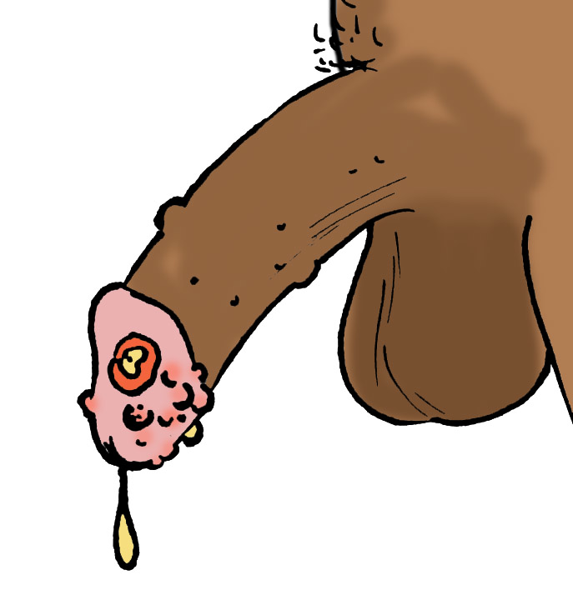
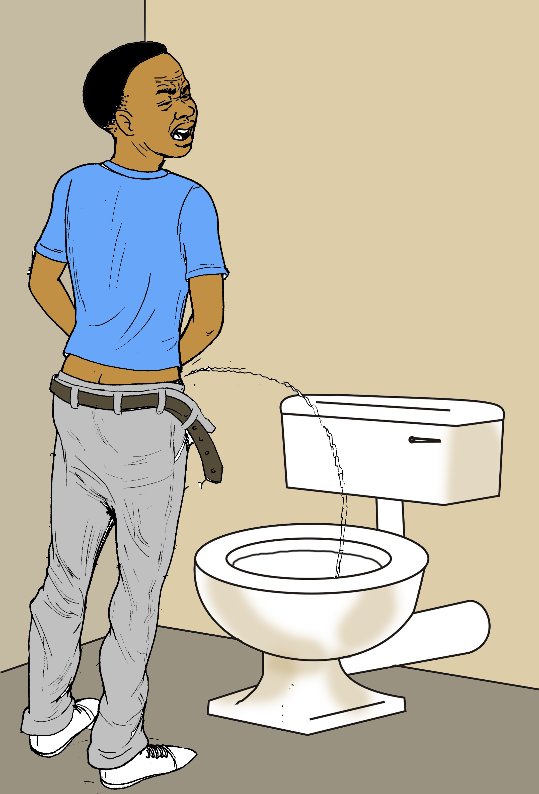
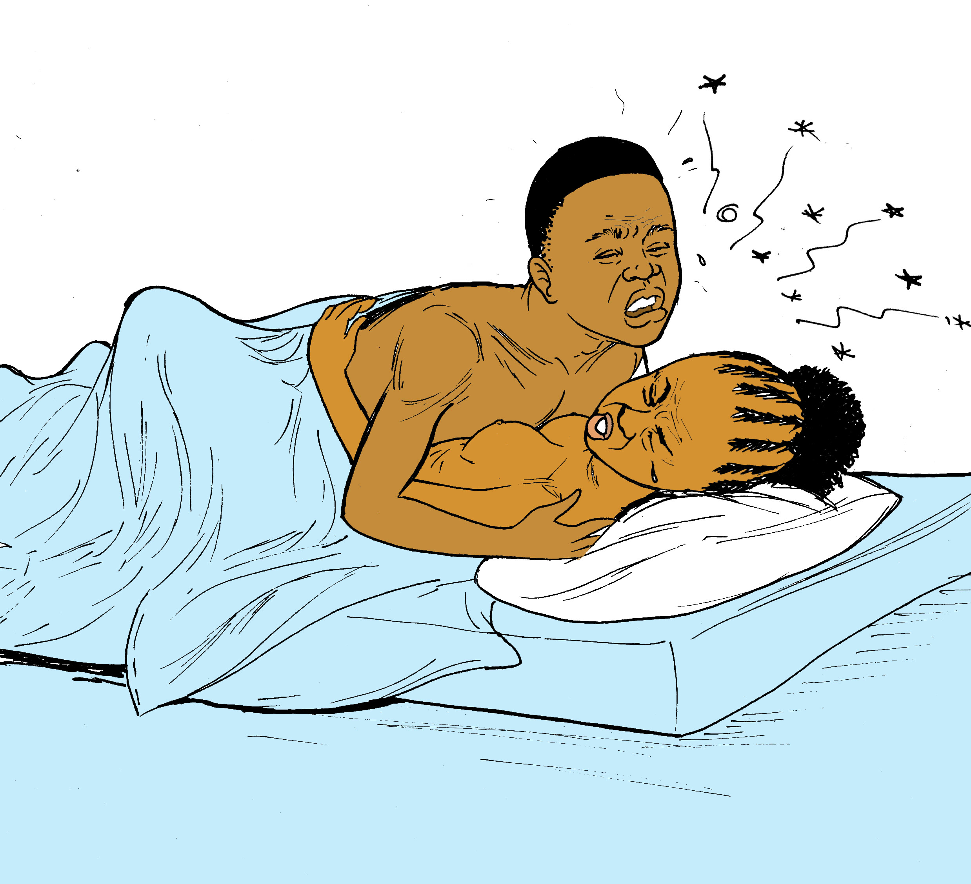
Sexually Transmitted infections
Symptoms of STIs can include:
Abdominal pain
Vaginal sores
Abnormal vaginal discharge
Pain during sex
Burning with urination
Some STIs can cause no symptoms in women, so it can be difficult to know if you are infected

Slide 34
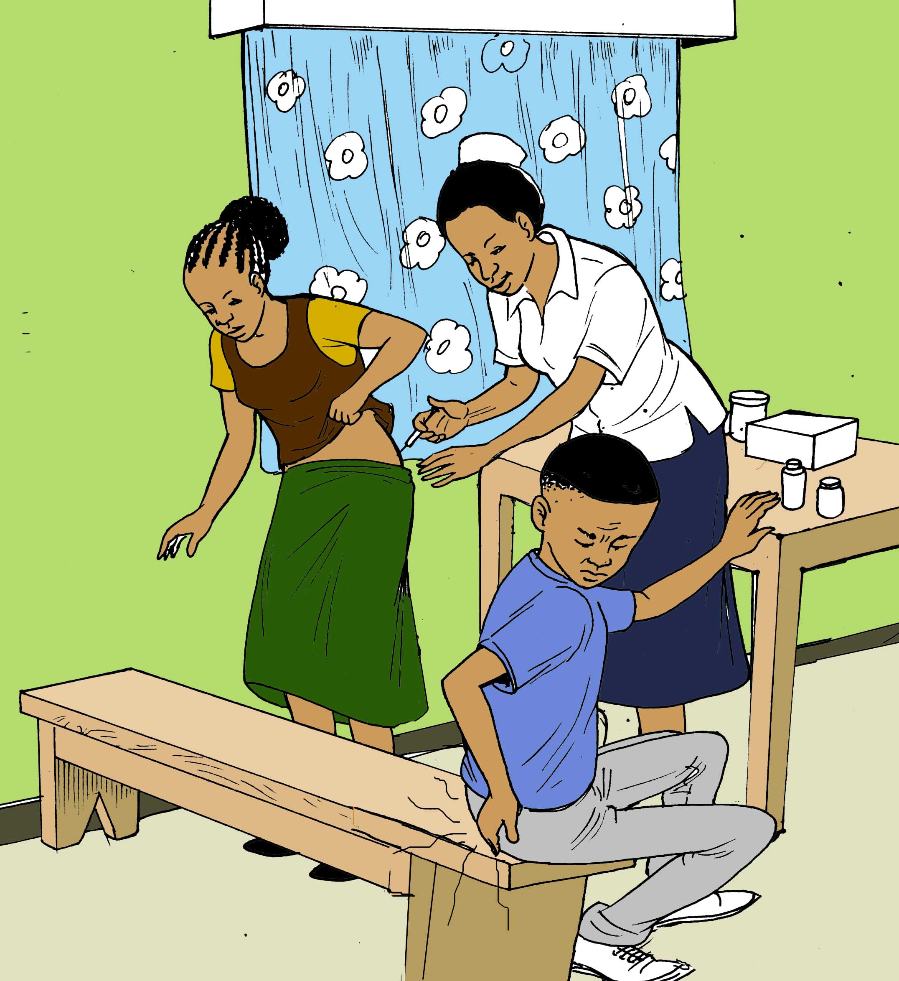
Sexually transmitted infections
If you are having symptoms of an STI, see a healthcare provider immediately. Some STIs can be cured with antibiotics, while others cannot be cured and may recur
It is important to prevent STIs or treat them as soon as possible, as some STIs can cause scarring of the uterus or fallopian tubes, which can cause infertility (inability to have a baby)
To protect yourself against STIs and pregnancy, it is important to always use dual method contraception

Slide 35
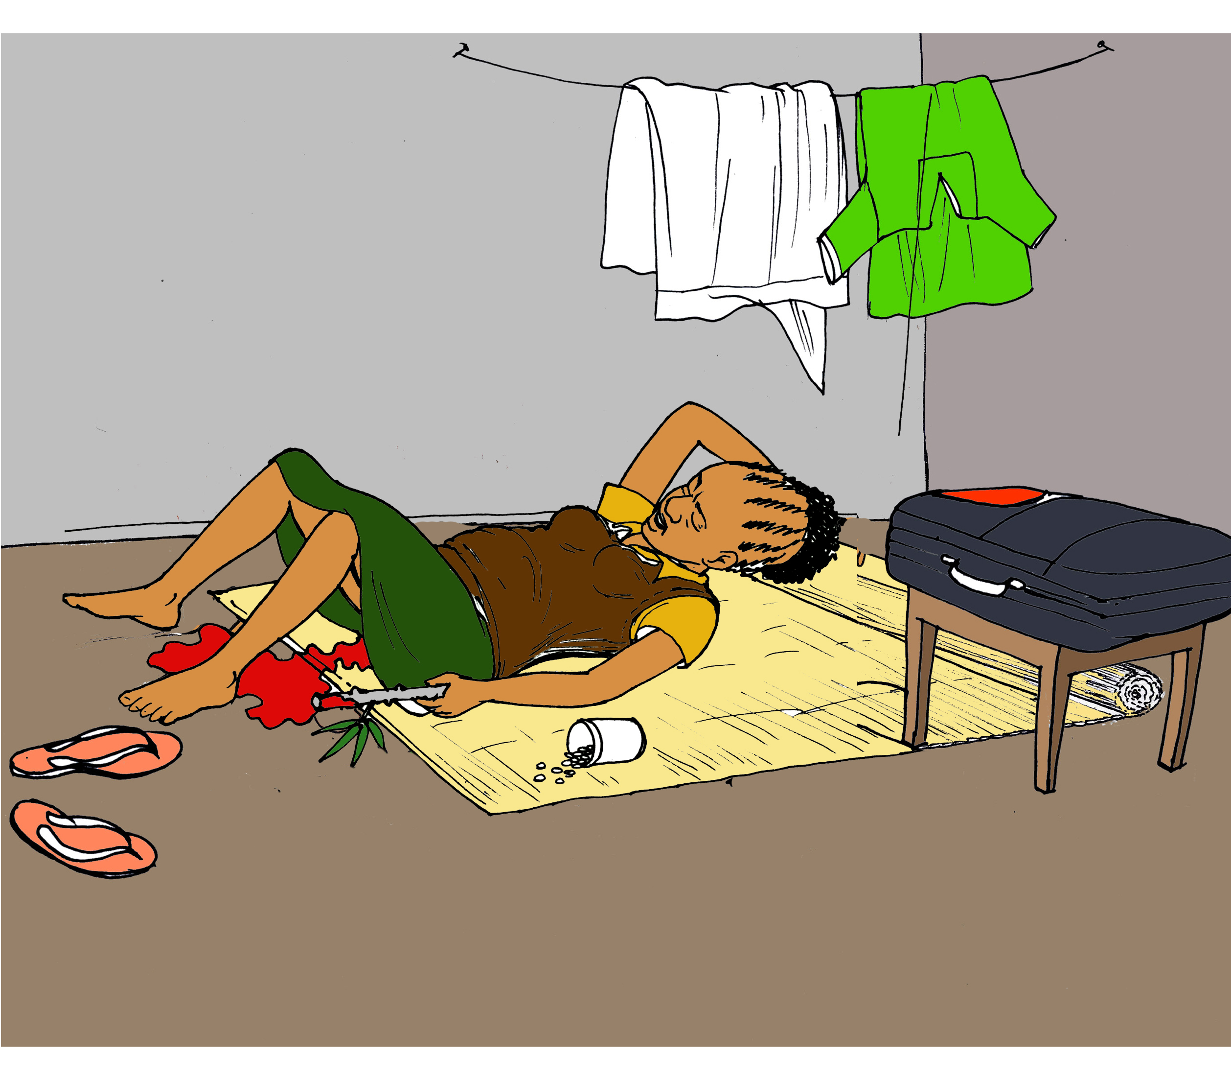
ABORTIONS
Abortions are currently illegal in Malawi
However, many young women in Malawi still find people to perform abortions
Most of these abortions are not done by trained professionals and can result in the following:
Infection
Infertility
Bleeding and anemia
Death

Slide 36
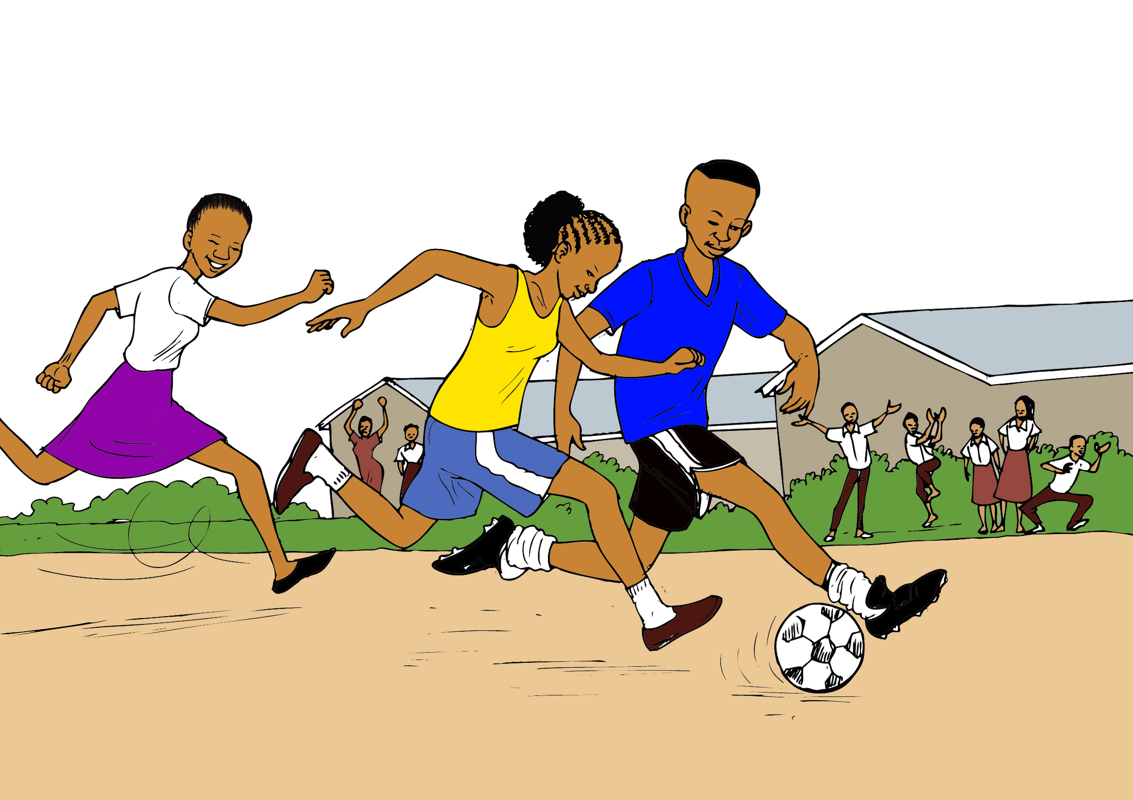
HEALTHY, HAPPY women
Abstinence is the best way to protect yourself from STIs, HIV transmission and pregnancy
If you do decide to become sexually active, always use contraception
If you use contraception properly, you can prevent transmission of STIs and HIV
Using contraception also helps you be able to delay getting pregnant until you and your partner are ready, and your body is ready to carry and deliver a baby safely

Slide 37



Acknowledgments
©2015 Baylor College of Medicine Abbott Fund Children’s Clinical Centre of Excellence Malawi, Lilongwe, Malawi
Illustrator: Rogers Chilemba
Creators:
Susan Hrapcak, MD
Susan Raine, MD/JD
Allyson McKenney, MD
Contributors/Translators:
Peter Kazembe
Anne Kantepa
Princess Munthali
Virginia Chopi
Mathilda Mwkatula
Imran Kachingwe
Cathy Chirambo
William Phakati
Makhumbo Bwanali
Princess Nyirenda
Symon Mtambo
Rachael Harawa
Gracian Chimseu
A special thanks to our patients for their valuable input

